Slide 1
Child Development Information System (CDIS) CDIS Admin Users Group
Thursday 2nd February 11am – 12pm

Slide 2
Contents
Tips and Tricks
Updating Addresses
Caregivers and Information Sharing set to ‘No’
Transfer of clients on CDIS
Q&A

Slide 3
Tips and Tricks
Open/Change/Close Client – ensure that children and all relevant relationships are open for service.
Tick Save and Open when entering a birth notice
When booking Home Visit in calendar add a note with the babies DOB and CDIS so that it can been seen in the appointment screen.

Slide 4
Updating Addresses
When PCG gives a new address please do not tick change for all family members as this will delete the history of addresses
Added separately to each family member ensures that address history remains. This is important for information sharing and identifying families.

Slide 5
Updating Addresses
If you click yes to the following when updating the new address:
Addresses from the family members history will be deleted and does not update the primary address
As you can see the Smith street address has been deleted and the primary address stays at Green ave.

Slide 6
Caregivers with Information Sharing set to ‘No’
What do you do when a parent calls up and asks when is the next MCH appointment but that parent has information sharing set to ‘No’?

Slide 7
Caregivers with Information Sharing set to ‘No’ (continued) Troubleshooting this scenario
Can I take your details and get back to you.
If concerned ask for MCH Team Leader to read the notes to assess risk
Offer to resend the invite to the PCG selected
Ask parent on the phone to talk to person listed as PCG to call and discuss information sharing permissions.

Slide 8
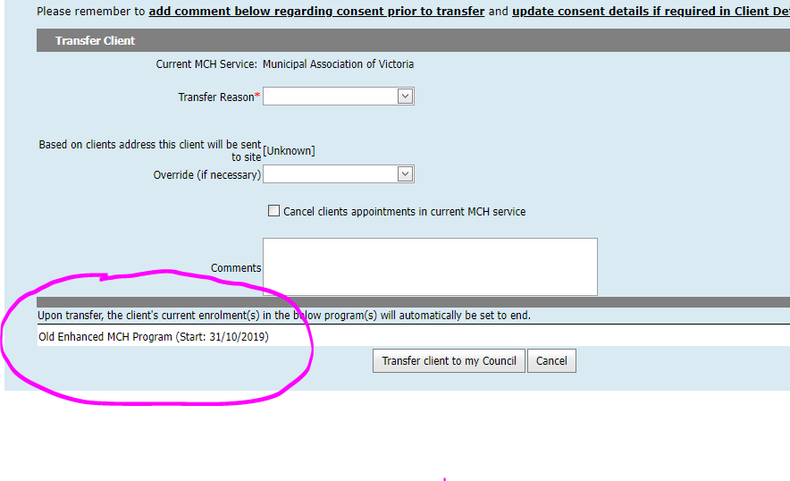
Transfer of clients on CDIS
If a client calls and says they have moved to another Local Government Authority (LGA)/Aboriginal Community Controlled Organisation (ACCO)/Health Service
Please direct them to call the new LGA or ACCO
DO NOT CLOSE the CDIS history
What do you do when you try to transfer a client and the following happens

Slide 9
Transfers when clients are enrolled in a program at previous LGA or ACCO.
Best practice is to call the LGA or ACCO to advise of the families move and need to transfer CDIS record.
This gives the LGA or ACCO time to either close programs or provide an update.
This may need to be referred to your Leadership Team
PLEASE DO NOT TRANSFER WITHOUT CONTACTING LGA or ACCO
PLEASE DO NOT “PUSH” A HISTORY TO ANOTHER LGA, we should only transfer into our own LGA. – as per CDIS Transfer Process on Dept of Health website

Slide 10
Reminders and Q&A
Follow the CDIS processes as these have been developed and tested for best practice and to ensure accurate reporting.
Data collection is an important part of our service for funding and trends.
Your questions, thoughts and discussions☺
Fathers with a new baby, can their history be pulled from the previous council?
Histories should only be transferred following a conversation with the family about the relevant histories of the family group in the new LGA - don't make assumptions and transfer histories (partner or children) without knowing the circumstances?

