Slide 1
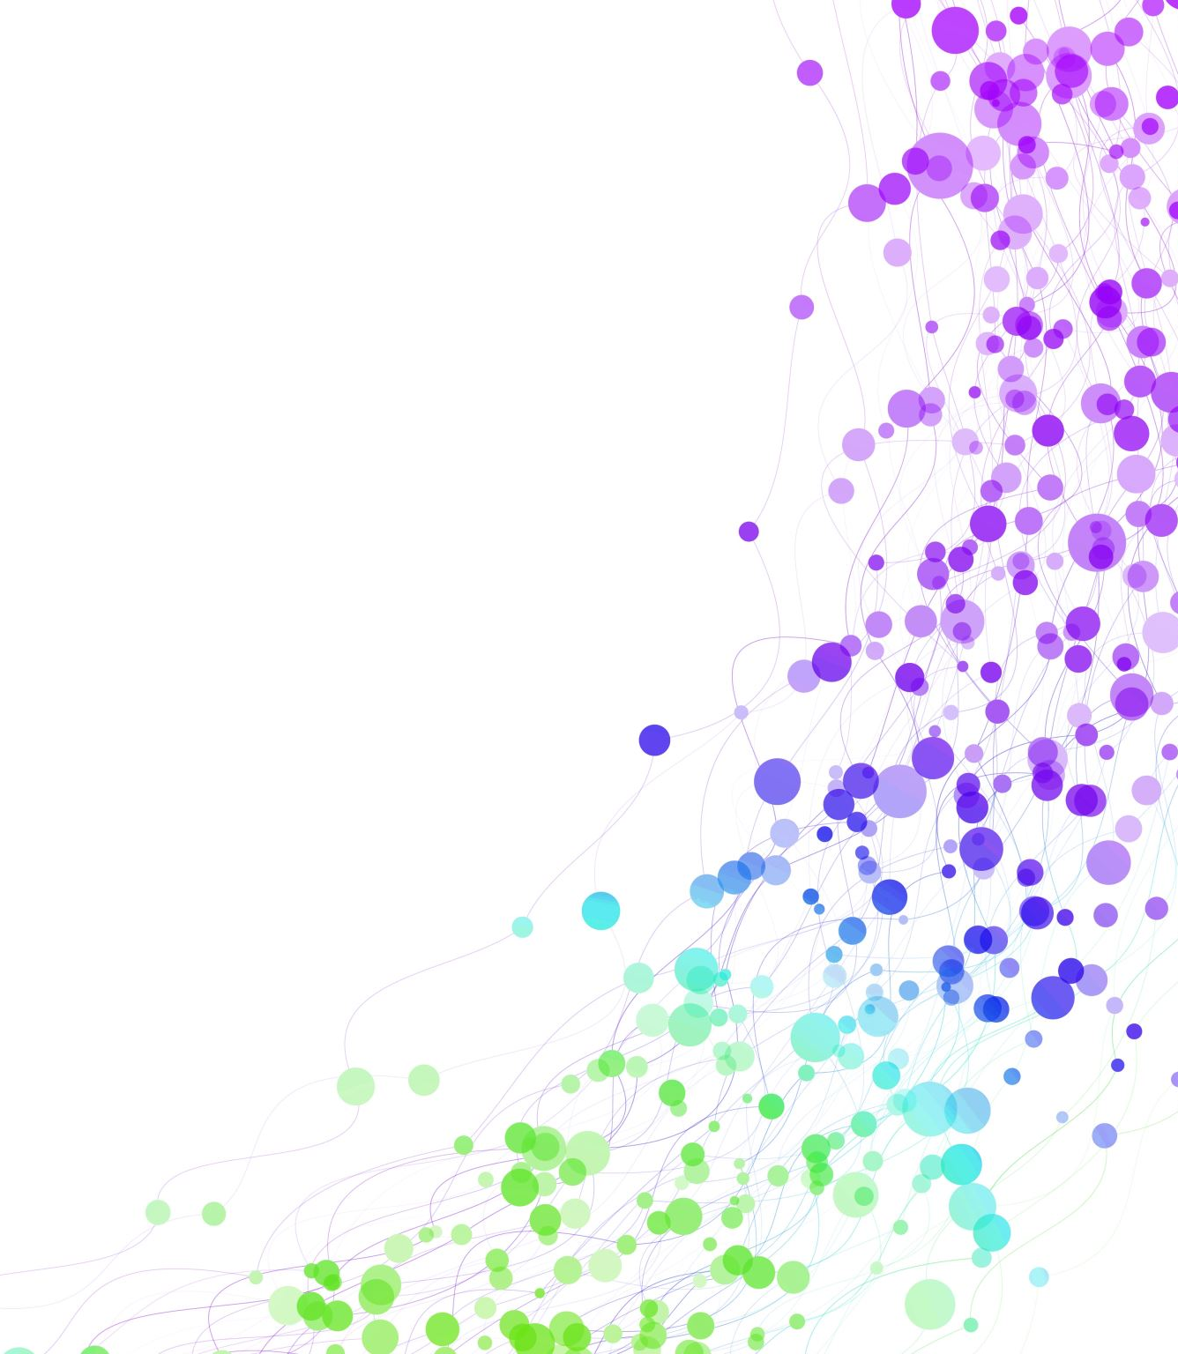
Child Development Information System (CDIS)
CDIS Admin Users Group
Tuesday 10th October 2023 11 am – 12pm

Slide 2
Contents
Tips & Tricks
Can I change a default site phone number to the central admin number?
Collaborative Service Delivery
Birth Notification Checklist - proposal
Birth Notice and Enrolment report CDIS and MCH resources
Q&A

Slide 3
Tips & Tricks
Data Cleansing Activity from https://vimeo.com/690719160
Key areas:
Reopening the PCG record when KAS consult is booked and double checking that the PCG is open to MCH service.
Birth Notification not removed from BN list.
Referrals review

Slide 4
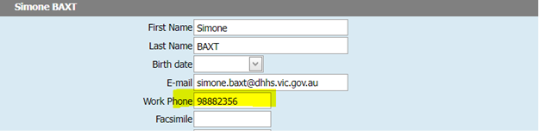
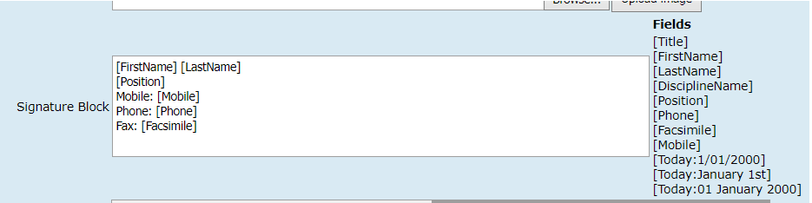
Can I change the default site phone number to the Central Admin Number?
For SMS client appointments: you need to complete a site request form signed by your Coordinator and email into CDIS support desk to change that contact number.
For Letter Templates:
Update their work phone number under Update Details > user settings to be the Central Admin number
2. Ask the person with the role of ‘System admin – council’ to go into Administration > Settings > Parameters and change/check the variables listed for the MCH service signature block and remove the info they don’t want. This will update what is displayed for ALL users though, based on individual’s user stetting

Slide 5
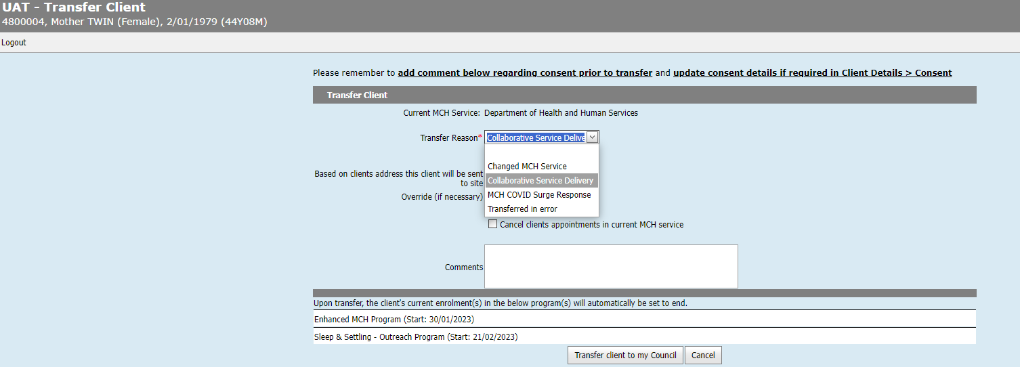
Collaborative Service Delivery
What does this option mean and what are the implications for transferring in under this option for groups/appointments/programs etc?
This transfer options is for LGAs working in partnerships with Aboriginal MCH services or other LGAs for service delivery.
When using this option, the collaborative provider will temporarily transfer the client into their service.

Slide 6
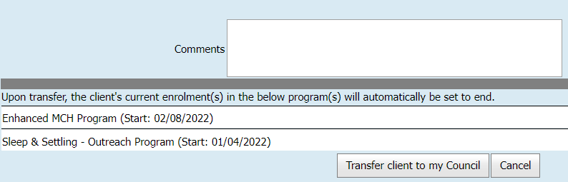
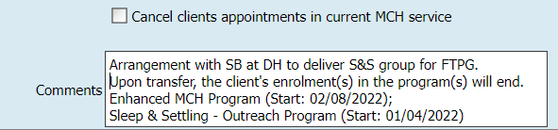
Collaborative Service Delivery
For lead clients, all programs (including integrated programs – EMCH and S&S) programs will be automatically closed on transfer.
For non-lead programs such as Breastfeeding support, NEP, etc they will be closed and any integrated programs they are included in will be removed.
Best Practice is for the Collaborative service to review any programs listed.
Copy and paste the Programs listed into the comments section prior to transfer.
Ensure communication with primary provider to ensure that programs are reinstated on transfer back to primary service.
Reference is Practice Note – group delivery from another service provider found on https://www.health.vic.gov.au/maternal-child-health/child-development-information-system?rid=212899

Slide 7
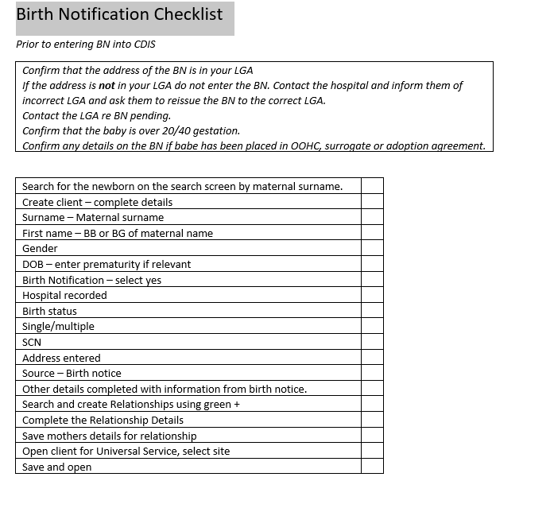
Have updated this template following discussions and added to the MS Teams Admin team chat with other templates
Notes:
Proposed BN Checklist – any feedback – would this be useful? New staff refresher

Slide 8
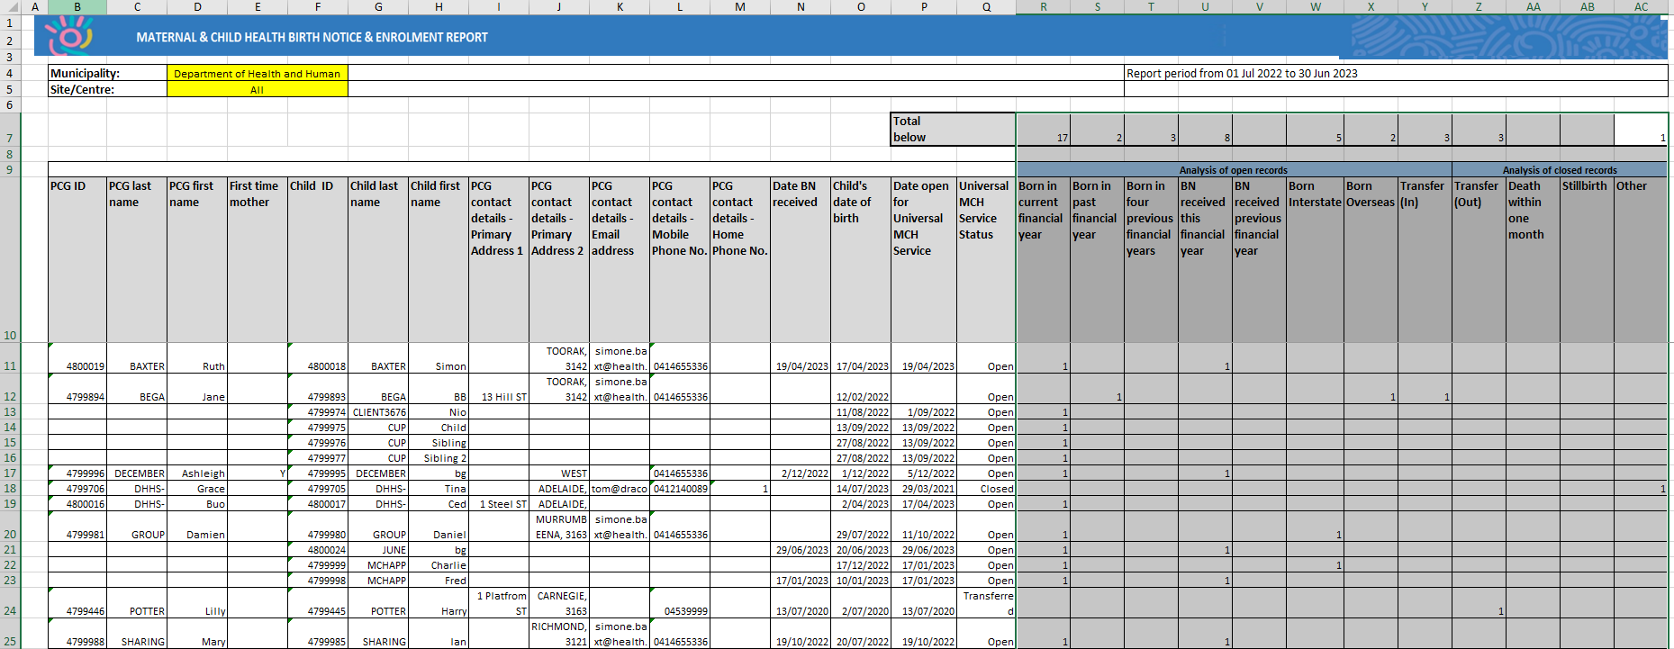
Birth Notice and Enrolment Report
Use this report to double check any queries on your annual report data in relation to your birth notices and enrolments - this report may indicate that there is data missing or inaccurate data in the health record.
Some questions have arisen about interpreting/understanding some data in this report.
If there are any concerns about the data best practice is to review and liaise with your Leadership team.
Notes:
from the Letter/Reports tab – data generated from the entry of birth notice so if not completed properly data will be missing. This can not be altered after the date of BN entered.

Slide 9
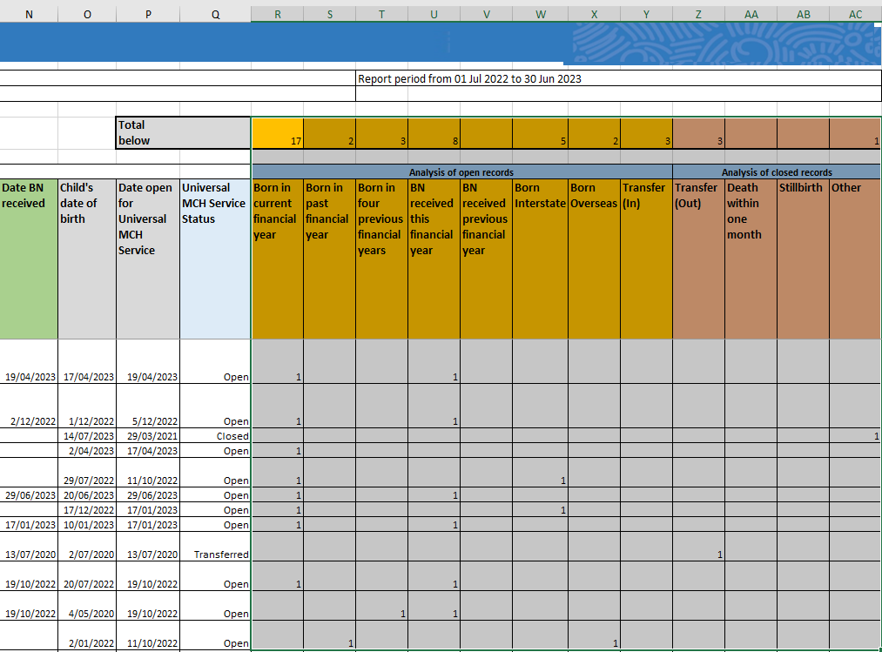
Birth Notice and Enrolment Report
Universal MCH Service status (column Q)
The status in this column, will determine the interpretation of data in the following columns;
Open: Review columns R - Y
Closed: Review columns Z – AC
Transferred: Review columns R-AC
Analysis of Open Records (columns R – Y)
A count will exist in one of these columns, corresponding with the data entry recorded for the Hx
Analysis of Closed Records
(columns Z - AC)
Transferred (Out): The client was transferred into another provider’s service (no longer in your service).
Death within one month: Based on correct entry in Hx.
Stillborn: Based on correct entry in Hx.
Other: The record was closed, and not because it has been ‘transferred out’, ‘stillborn’, or “death within one month”.
Date BN Received (column N)
This must be entered when the birth notice is added to CDIS. If it isn’t, there is no way to retrospectively update this, and the column will be blank
Notes:
BN date row cannot update. This will be blank if you do not receive a BN eg born interstate or O/S. Workaround – create a new history with BN and merge the records. When the 2 records are merged make sure that the new record with the BN date in it is the record merged to/main record.
Universal – open/close/transfer – pick up your closed clients that may need to be opened.
Analysis – shows the active record status ie when opened/transferred etc. Shows status of closure.
This report may indicate that there is data missing or inaccurate data in the health record.
This will be expanded on in the reporting sessions for leadership.

Slide 10

Calander processes and responses
How do you set up your Calanders for your service?
Recommended prepopulating public holidays, admin time, team meetings, lunch breaks
Some service this is managed by admin team or clinicians
MCHN or clinicians name at the top of the calander
Do you pre-populate with appointments and for how far in the future?
Yes HV, 2wk, 4wk, 8wk and 4mth KAS spots prepopulated up to 6-12mths in advance

Slide 11
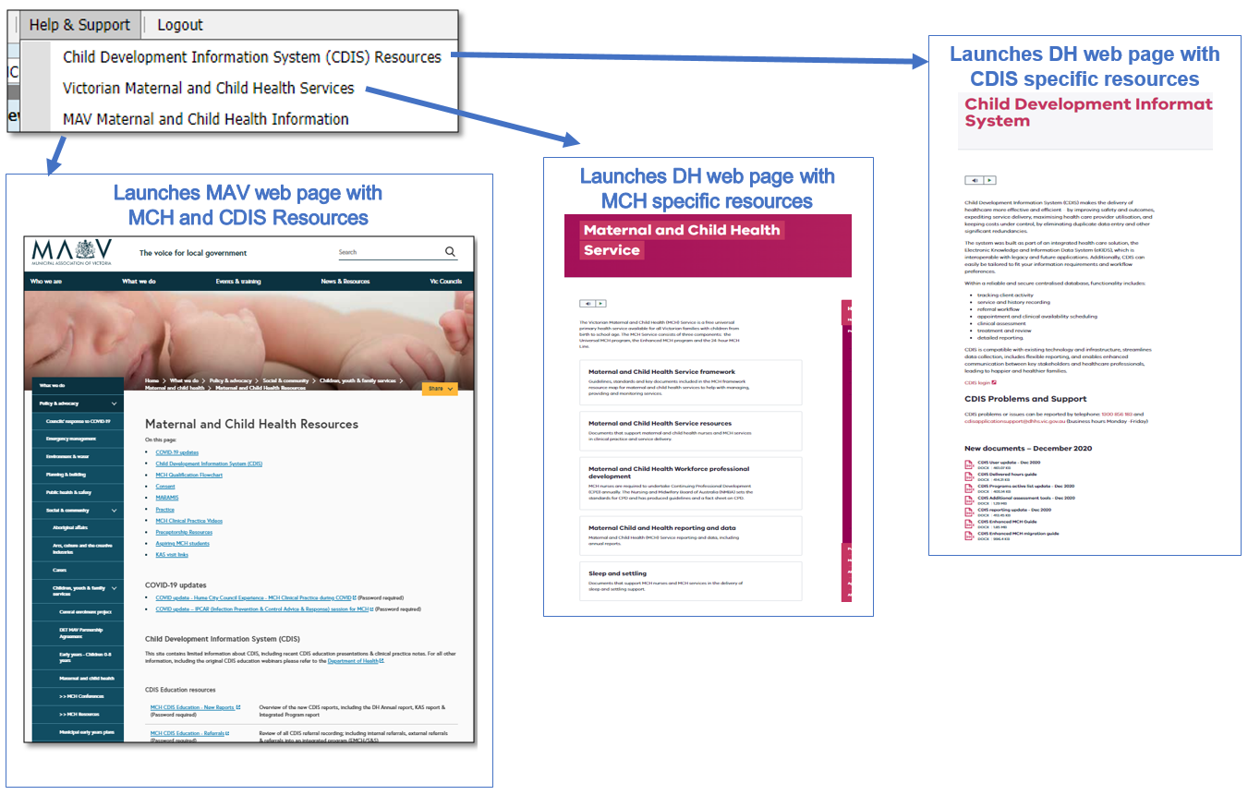
MCH Resources
Vimeo Password – cdis
MCH Clinical Practice videos password – mchvideos
Notes:
Password for vimeos = cdis

Slide 12
CDIS Support – CDIS User Responsibilities
When you are experiencing a CDIS issue / problem / question:
Check internally with your team leader / coordinator / CDIS Champions to validate what’s happening in CDIS. Include this in your request for support.
If your issue is connecting to CDIS, please check with your local IT professional if there is a network issue.
Are you the only one with the issue or are others experiencing this too? When was this problem first noticed? Include this in your request for support.
Check the online resources available to you, and if you're not closer to resolution, escalate to Contact CDIS Helpdesk on 1300 856 183 or cdis@support.vic.gov.au with the following important detail
In summary what is question or problem?
  What screen are you using / what actions are you doing in CDIS,
  What is the outcome you’re expecting?
  What is actually happening instead?
  NB: Client ID (not personal details)
Take a screen capture of the error or copy and paste the URL (web address),the name of the screen you’re using. For reports, detail the year or data range you’re using, and any other data selections, and capture the error message.

Slide 13
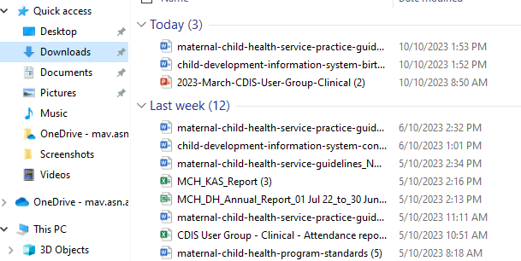
Question time
How secure are the reports/documents you download from CDIS?
Your 'Browser Download History' is pulling the reports from the 'Downloads' folder on your device/computer. So, the security level is dependent on how secure your device is (encryption, password protection, MFA, IT processes for wiping devices etc.).
See snip on left of the Downloads storage – any service guidelines, reports and letters that you download are stored here.
You need to routinely empty your downloads folder on your device and then also empty from trash.
TIP: Check in with your IT department regarding security of these documents.

Slide 14
Questions and Answers
What are council doing for appointment times in general?
HV can be 60mins, 75 mins or 1.5hrs including travel depending on LGA.
Multiple councils are running all KAS for 45mins
Other councils continue to run a mix of 30 and 45 mins for KAS consults.

Slide 15
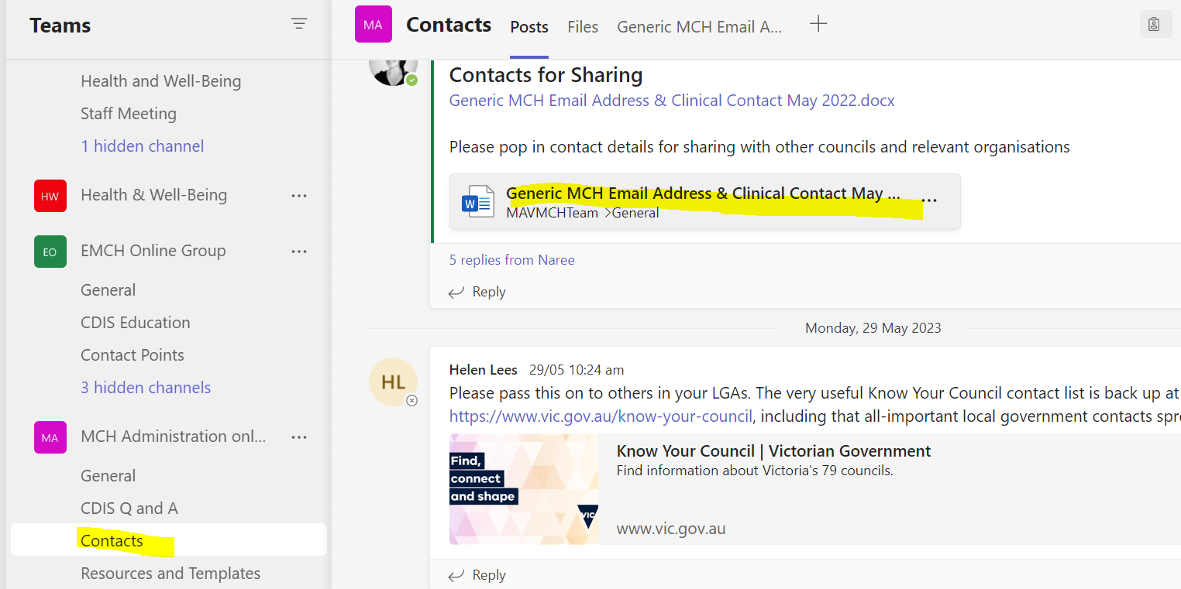
Questions and Answers
Can we have a generic admin email list for communication?
On the MS teams Admin chat site there is a list under contacts see highlighted yellow below. Ensure that this is up to date with correct generic email and contact number for your team.

