Slide 1




CDIS User Group – Clinical & Admin
April 2025
CDIS User Group –l April 2025

Slide 2

Agenda
Relationships
Addresses
Hyperlinks
Universal Active List
Sorting the Active List
Suggested process for missed visits follow up
Bulk SMS
Manual Bulk SMS process
Q&A
CDIS User Group – April 2025

Slide 3
Relationships – creating histories for older siblings or family members not using the MCH service
Current CDIS practice is to create a health record for every family member of the child even if they are not currently using the MCH service eg a sibling who is aged over 6yrs.
The history is created to show the family members of the child but is closed to service.
Are we in breach of the HRA in creating a medical record for individuals not using not using our service?
The collection of the information is likely to be permissible as the collection of the child’s family and family history is fundamental to respond to the needs of the child and family as part of the MCH service. Accordingly, it may be implied by law as being authorised or permitted under law. (MAV Legal Counsel)
Health Privacy Principles outlined in Schedule 1 of the Health Records Act, outline when health information can be collected. Specifically, HPP 1.1 outlines when health information may be collected. The information collected must be necessary for one or more of the functions or activities of the MCH service
Best Practice – History is created to provide a complete picture of the family but closed to service and not used to record any clinical notes
CDIS User Group – April 2025
Notes:
Further guidance to follow.

Slide 4
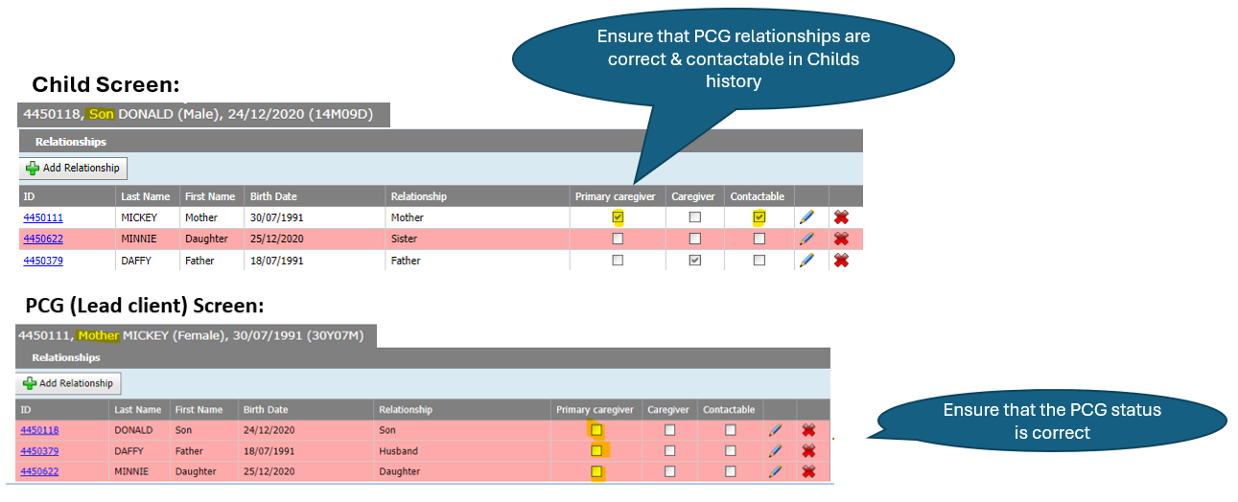
Check Relationships
CDIS User Group – April 2025
Notes:
To ensure that relationship settings are correct, it is easiest to check from the child screen.
The child should have a primary caregiver and will often have a secondary caregiver.
Note that there is no primary care giver marked when we look at the Primary Care giver screen.

Slide 5
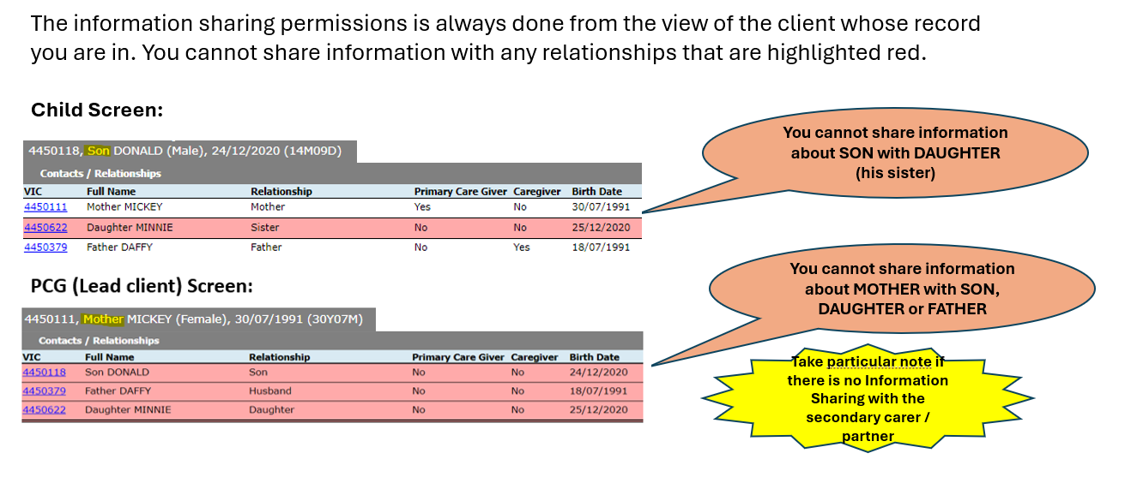
Check Information Sharing permissions
CDIS User Group – April 2025
Notes:
The easiest way to get the relationships correct is to also work from the child screen.
The information sharing permissions is always done from the view of the client whose record you are in. You cannot share information with any relationships that are highlighted red

Slide 6
Addresses – Q&A
When a child is placed in out-of-home care and then returns to their parent's care, the health record may be subpoenaed for court. In such cases, the foster parents' details and address could be disclosed to the biological parents, which may pose a safety risk to the foster parents.
Is it possible to remove the foster parents' address from the record and include a note in the history instead?
Do not delete information from the health record, including the foster carer’s address, as there are requirements under the 4.2 of Schedule 1 (The health privacy principles) of the Health Records Act in relation to deletion of records.
If a court subpoenaed the council’s records, council is required to provide the records, without any redactions. However, if the council considers there may be a risk to an individual if certain information is released, it can make an application to the court requesting that the documents, or part of them not be provided or made available to the other side or the public (what the council requests will depend on the potential risks). This could be done on the basis that disclosing the personal information of the foster carer, such as their name or address may cause a risk to their safety or risk to other foster children etc. The court can consider the risk and then determine whether it will not allow certain aspects of the documents (such as names and addresses) to be provided to the other side or make the documents not available to the public, depending on the potential risk.
CDIS User Group – April 2025
Notes:
A history of addresses can help to identify the right CDIS record
Can show on UAT how to attach family member and not transfer in

Slide 7
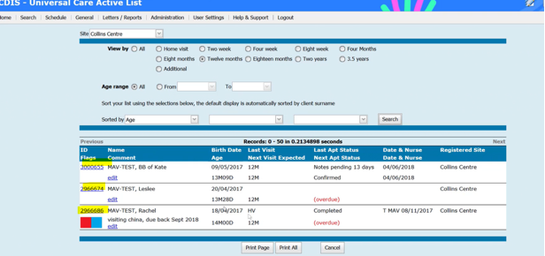
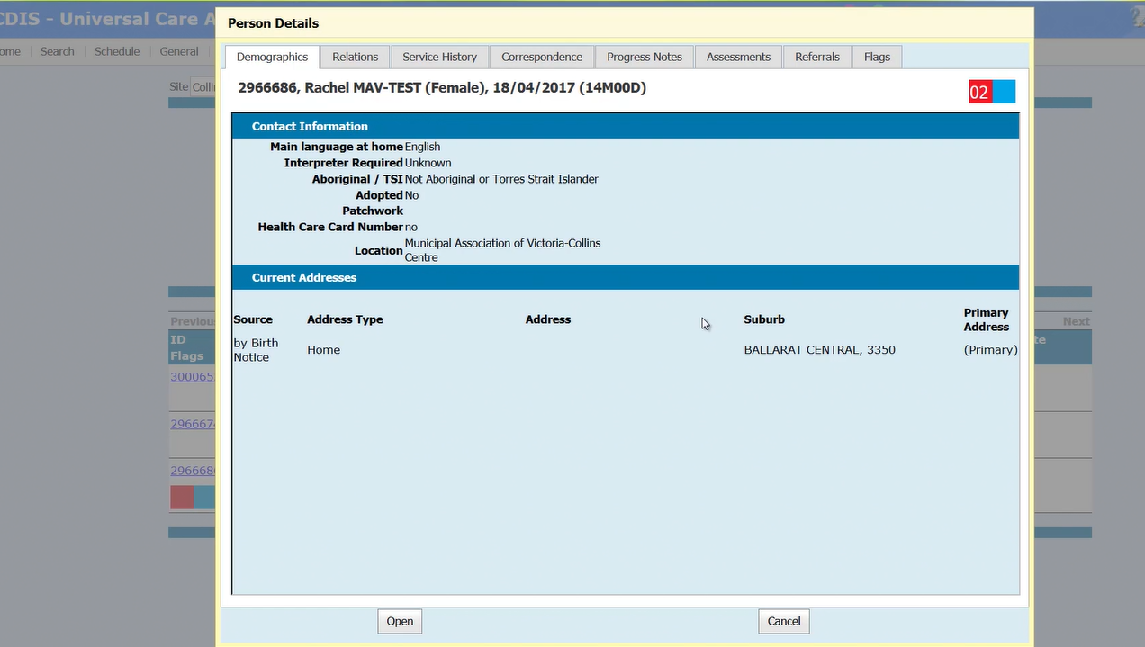
Hyperlinks in CDIS
You can see that the CDIS ID is blue – this is a hyperlink to
the child's CDIS record ed EDIT word to record comments.
If you click on the Hyperlink on their CDIS ID it will create a pop-up record.
From the pop-up record – you can click on the tabs in the top menu to review information
You can also see the “progress notes” from last appointment, review any flags etc or open the full record by clicking “open” at the bottom of the screen
CDIS User Group – April 2025

Slide 8
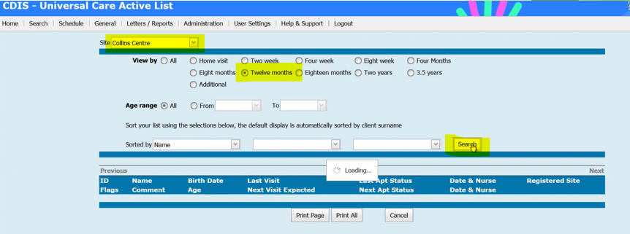
Universal Active List
Home screen >menu “General” >“Universal Active List
Use the Universal Active list to check for clients who are overdue for their KAS visit at a site
Choose Site > Collins Centre
Age > 12m KAS
Click > Search
VIMEO - https://vimeo.com/432022192
CDIS User Group – April 2025
Notes:
A

Slide 9
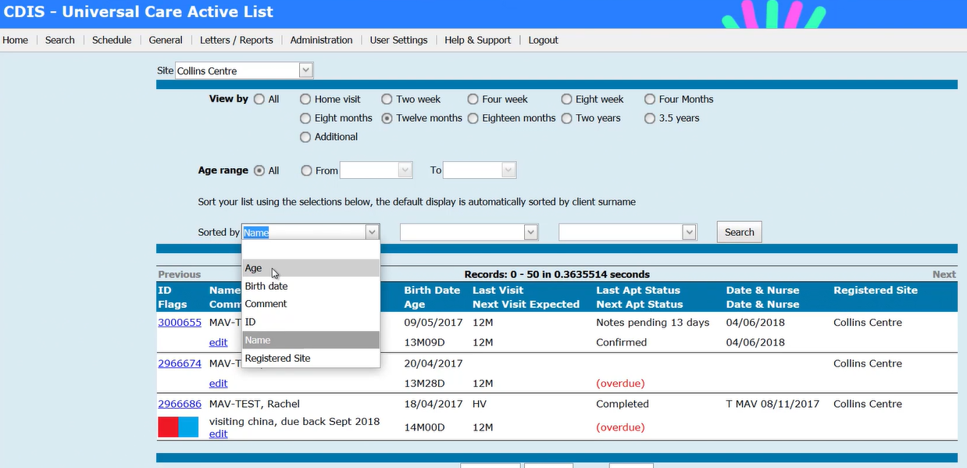
Sorting the Universal Active List
Click on first drop down sorted by menu
Choose Age – this is usually the easiest menu to sort by.
Click Search to sort.
List of clients overdue for visit will be appear sorted by Age.
CDIS User Group – April 2025
Notes:
A history of addresses can help to identify the right CDIS record

Slide 10
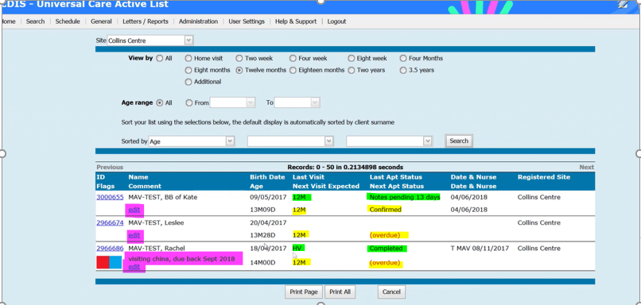
Sorting the Universal Active List
You can then see the list of clients overdue for 12mth appt
The list will show you the relevant KAS, status of last consultation and the next expected consultation for 12mth KAS.
BB of Kate - overdue for 12m KAS, you can see she has an appointment booked in the calendar – so it comes up “confirmed”
Leslee - overdue for 12m KAS – see ref “overdue” means no appointment is booked for this KAS
The “edit” note can be used as documentation of any follow up eg 26/3/25 P/C and VM left to book appointment. MR. This edit note is only available on the UAL.
Rachel – we can see her Last KAS completed was the HV and there has been a service gap. As you can see there is an “Edit note” explaining that child was in China and when she was due back.
Rachel - overdue for 12m KAS with no appt booked
BB of Kate - has “notes pending for last appt status, this indicates the appointment remains in the CDIS calendar, not completed and not cancelled.
The list also allows you to see if there are any flags pertaining to the child and can help you to prioritise who to contact first.
CDIS User Group – April 2025

Slide 11
Suggested Process for Missed Visits Follow Up
Suggested process for best practice:
Regular monthly (at least) review of missed visits for each site/centre.
Phone call to client to book appointment
If no answer, leave a voice message.
Send a follow up SMS from CDIS if you don’t manage to speak to client.
Pop a note into the “edit” section of Universal Active list i.e “31/8/22 TC to client re missed visit, message left and follow up SMS sent. AS”
If you speak to client, record contact under “Client not present”
If you call client and leave a message, also record contact in client notes via “client not present”. ie. “Call to Rachel re missed 12m visit, no answer, voice message left on mobile”.
Also check parent and sibling notes for updated details such as a new phone number or address that may not have updated in child record.
*Appointment reminder settings need to be set to Mobile / SMS for this to be possible.
Please review your own MCH service’s protocol re missed appointments.
CDIS User Group – April 2025
Notes:
Process LGA specific – review your own MCH service’s protocol

Slide 12
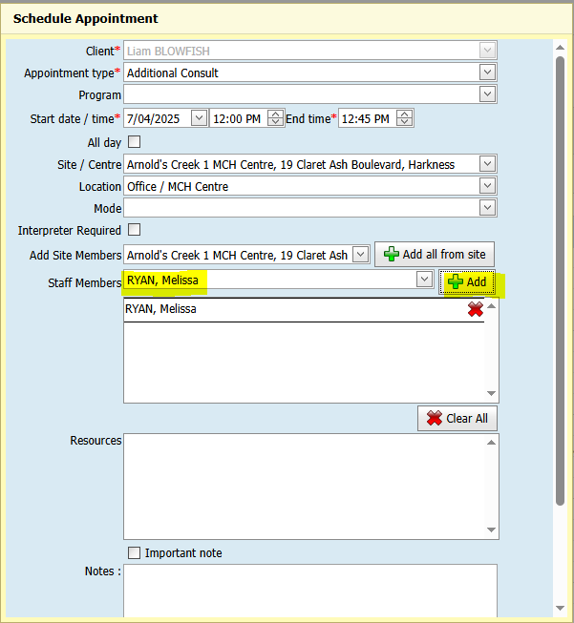
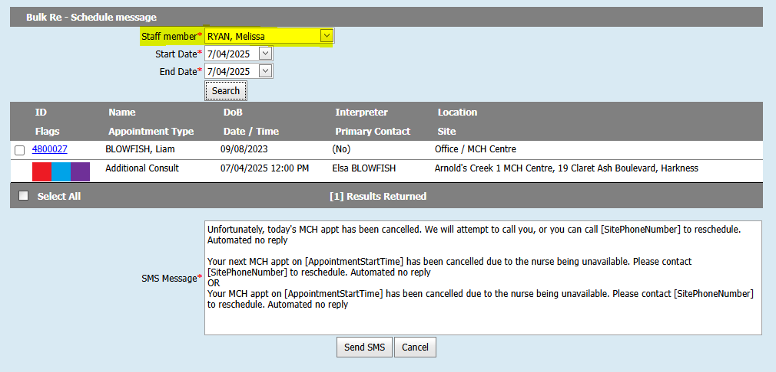
Bulk SMS Re-Schedule
The Bulk SMS screen can be used for rescheduling appointments.
Can only be used for service providers that assign staff to appointments when scheduling these.
From the Home screen, click on the Menu named Schedule > Bulk SMS Re-Schedule, to open this screen.
The first image highlights where staff members can be added to client appointments. This can be done during the initial scheduling or edited/added later.
The second image shows the Bulk SMS Reschedule screen and how the search can then be conducted using the relevant staff member and date range.
Example - client appointment
with Staff Member
CDIS User Group – April 2025

Slide 13
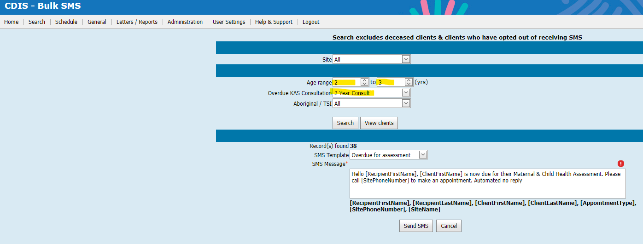
Bulk SMS
The Bulk SMS function in CDIS is available to send
bulk ‘overdue’ KAS SMS reminders to families
Please note that many LGAs are choosing not to
utilise this function due to the age parameters
set for the ‘overdue KAS’
Overdue 12m KAS will be any child between age of 12m-18m who hasn’t yet had the 12m KAS (i.e. children who at 17m3w will get an overdue KAS reminder).
Overdue 18m KAS will be overdue children between 18m-2y. Overdue 2y KAS will be any overdue child between 2y-3.5y.
*If an age range of 2-3 years is put in this will restrict this to children between 2y-3y (i.e. 2y11.5m will get an overdue KAS reminder)
CDIS User Group – April 2025

Slide 14
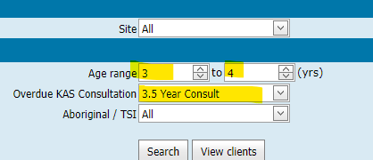
Bulk SMS example
If utilising the 3.5y KAS, you must ensure to put age range of up to 4years, or else it will include children above this age. Again, this list will include children 3y11.5m getting an overdue 3.5yr KAS reminder
It will not pick up children who are technically not listed as ‘overdue’ in the universal active list, as per demonstrations in previous slides
You can click view clients to check who will receive the SMS but you cannot select clients who will receive this reminder, it is all or none.
This will SMS all clients overdue at the time of the report, therefore if run regularly clients within those age parameters will get a new SMS reminder each time.
This SMS correspondence will be saved in the client file.
CDIS User Group – April 2025

Slide 15
Manual Bulk SMS Process
An alternative to the Bulk SMS function is using the Universal Active List report. This report will provide you with a list of children, within the set age parameter, who have not yet had or booked the KAS selected.
You can scroll across to the PCG field to gather the mobile number/email to send a KAS reminder to.
This can be done by an external SMS provider or email service.
This will assist in the overdue KAS issue shown in previous slide, but as it is a workaround there is still a risk that some clients may ‘slip through’ this reminder process
This method is best utilised for a blanket follow up of a large number of clients. The individual calling & reviewing of the universal active list is best practice for follow up of vulnerable clients in particular.
This method will not document any correspondence in the clients CDIS record.
CDIS User Group – April 2025

Slide 16
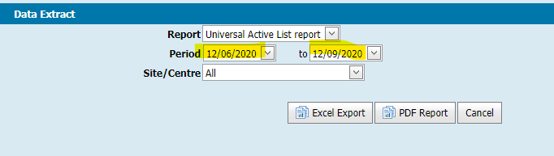
Manual Bulk SMS Process
  Letters/Reports>Data Extract> Universal Active list report
  This data in this report is used to send a bulk KAS reminder via an alternative SMS/email service.
  Put in selected dates that match appropriate age parameters
  I.e. for 2y KAS reminders would put in date range between 2yo-2.3yo (12/6/2020-12/9/2020)
  This will show ALL CHILDREN in your MCH Service within this age range.
  This can be done for the whole LGA or independent centres.
  ***For larger municipalities, this report may be difficult to run for a large client group.
CDIS User Group – April 2025

Slide 17
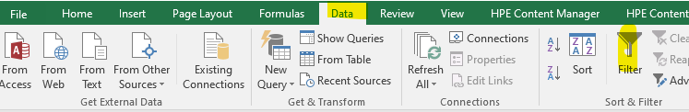
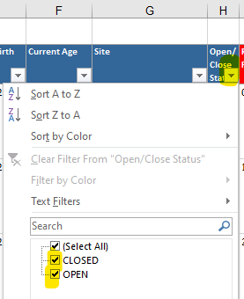
Manual Bulk SMS Process
The UAL report is an excel report and can be filtered to include only children overdue the KAS
  Click anywhere on the sheet
  Select Data> Filter
The columns will now have filter options (by clicking on arrow next to the column)
*Demonstration of excel filtering available in Data cleansing training webinar
https://vimeo.com/690719160
CDIS User Group – April 2025

Slide 18
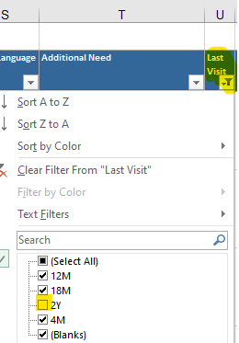
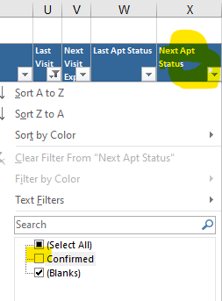
Manual Bulk SMS Process
For Bulk SMS reminders it is recommended to review & filter the following:
Double check the child age parameters you have run off is correct
                Filter out all closed records
                Filter out those who have already had the KAS you are doing the reminder for
  (i.e. if doing 2y KAS reminder, filter out Last visit >2y)
  Filter out those who have their 2y KAS appointment booked.
    Via Next Apt status>confirmed
  Filtering by flags is available if further prioritisation required.
CDIS User Group – April 2025

Slide 19
CDIS Support (continued)
CDIS Support Hours
Monday to Friday between 8:30am to 5:30 pm
Contact
1300 856 183
cdis@support.vic.gov.au
CDIS User Group – April 2025

