Slide 1
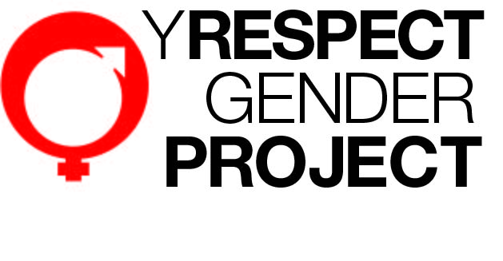
Gender is not a dirty word
Possibilities and Pitfalls of
Primary Prevention in the workplace

Slide 2


Acknowledgement
The first peoples of this land.
The first peoples of this work.

Slide 3
Y Respect Gender Project
VicHealth Creating Healthy Workplaces Program
Stress Pilot Project
Prolonged Sitting Pilot Project
Alcohol related harm pilot project
Race-based discrimination pilot project
Violence against women pilot project

Slide 4
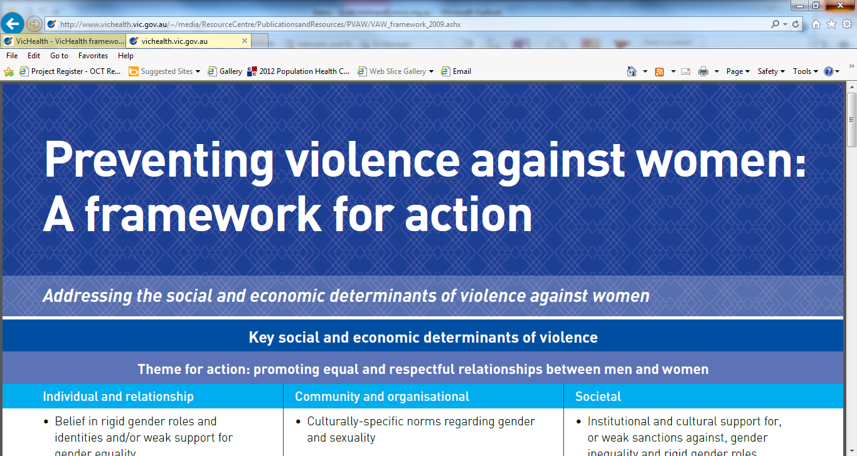
Y Respect Gender Project
VicHealth Preventing Violence Against Women projects
Preventing Violence Against Women Framework

Slide 5
Y Respect Gender Project
Evaluated by Australian Research Centre in Sex, Health and Society (ARCSHS)
Evaluation still on going
Practitioners comments

Slide 6
YMCA Victoria
In Victoria since 1853, not-for-profit charity
Operating at over 160 sites, mostly in Victoria, but also NSW, ACT and SA
Rec centres, student accommodation, childcare, camps, youth work, disability, stadium sports, swimming education, outdoor pools, parenting and other community development
Over 6000 staff and another 1500+ volunteers
Staff profile 70/30 women / men
Around 80 % staff casual or part time

Slide 7

Gender Framework
Judith Butler ‘Gender Trouble: Feminism and the subversion of identity’
Gender is not a real thing
An idea/concept that supports an unequal system
The idea is reinforced by the myriad of ways we perform gender and the way those performances are either rewarded or penalised

Slide 8
Gender Framework
“The disciplinary production of gender effects a false stabilization of gender in the interests of the heterosexual construction and regulation of sexuality within the reproductive domain. The construction of coherence conceals the gender discontinuities….in which gender does not necessarily follow from sex, and desire, or sexuality generally does not seem to follow from gender…”

Slide 9

Gender Framework
“When the disorganization and disaggregation of the field of bodies disrupt the regulatory fiction of heterosexual coherence…the regulatory ideal is then exposed as a norm and a fiction…”
(my italics)

Slide 10
Gender Framework
Butler explores the way the production and disruption are performed through the physical body.
What happens when we think of the organisation as a body where production and disruption are performed?

Slide 11

Workplace Gender Performance
Allocation of formal roles
Who does what
Recruitment / selection / promotion
The culture of different roles
Gendered groups

Slide 12

Workplace Gender Performance
Allocation of informal roles
Committees, project teams, odd jobs
Valuing and disvaluing of tasks
Processes of recruitment / selection

Slide 13

Workplace Gender Performance
The social life of the workplace
Who takes responsibility
Types of events organised
Gendered culture

Slide 14

Workplace Gender Performance
Work-based interactions
Meeting behaviour (leaning in / leaning out)
Forming / storming / norming

Slide 15
Workplace Gender Performance
Interpersonal relationships
Gendered groupings
Friendships
Social interactions outside of the workplace

Slide 16
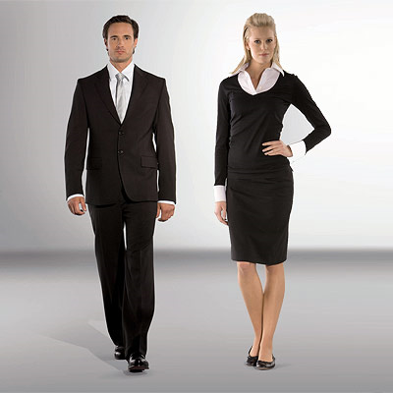
Workplace Gender Performance
Non-verbal environment
Clothes
Office Décor
Office Layout (closed offices
/ open plan desks)

Slide 17
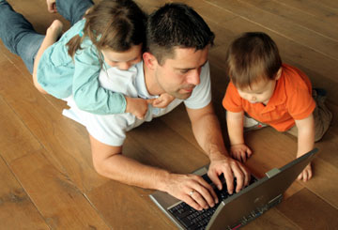
Workplace Gender Performance
Employment conditions
Full time / part time / casual
Use of flexible work
Use of parental leave
Return to work practices

Slide 18
Workplace Gender Performance
Language
Position descriptions
Formal documents

Slide 19
Possibilities, possibilities!
Drawing attention to the performances
Critiquing / deconstructing the performances
Disrupting the performances
Offering alternative scripts
Building individual capacity for deviation
Building corporate capacity for deviation

Slide 20
Y Respect Gender Project
Information / awareness raising / cultural change
E-newsletters
Social marketing events (White Ribbon & International Women’s Day)
Presentations at internal forums
Induction processes

Slide 21
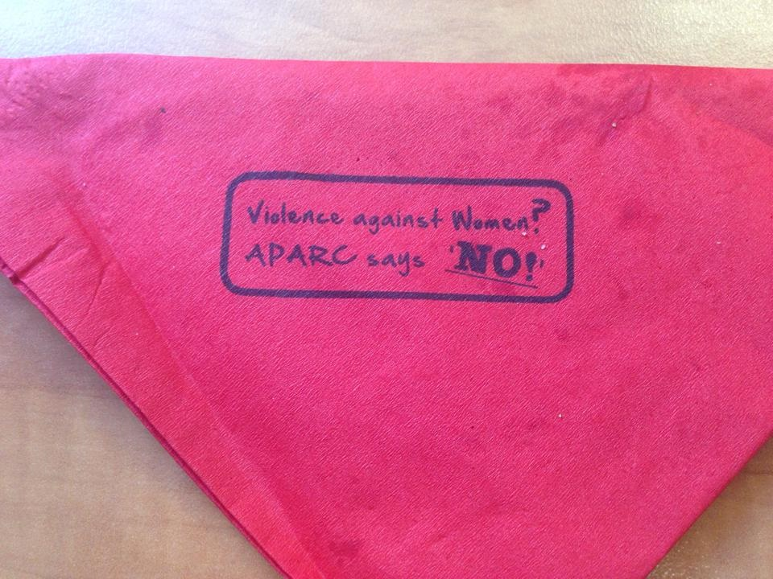
Ashburton Pool and Recreation Centre White Ribbon Barbecue

Slide 22
Y Respect Gender Project
Individual capacity building
Involvement on project team and reference group
Encouraging staff to attend external training / forums
Linking individuals to networks / other projects
Workshops and other training
Mentoring and support

Slide 23
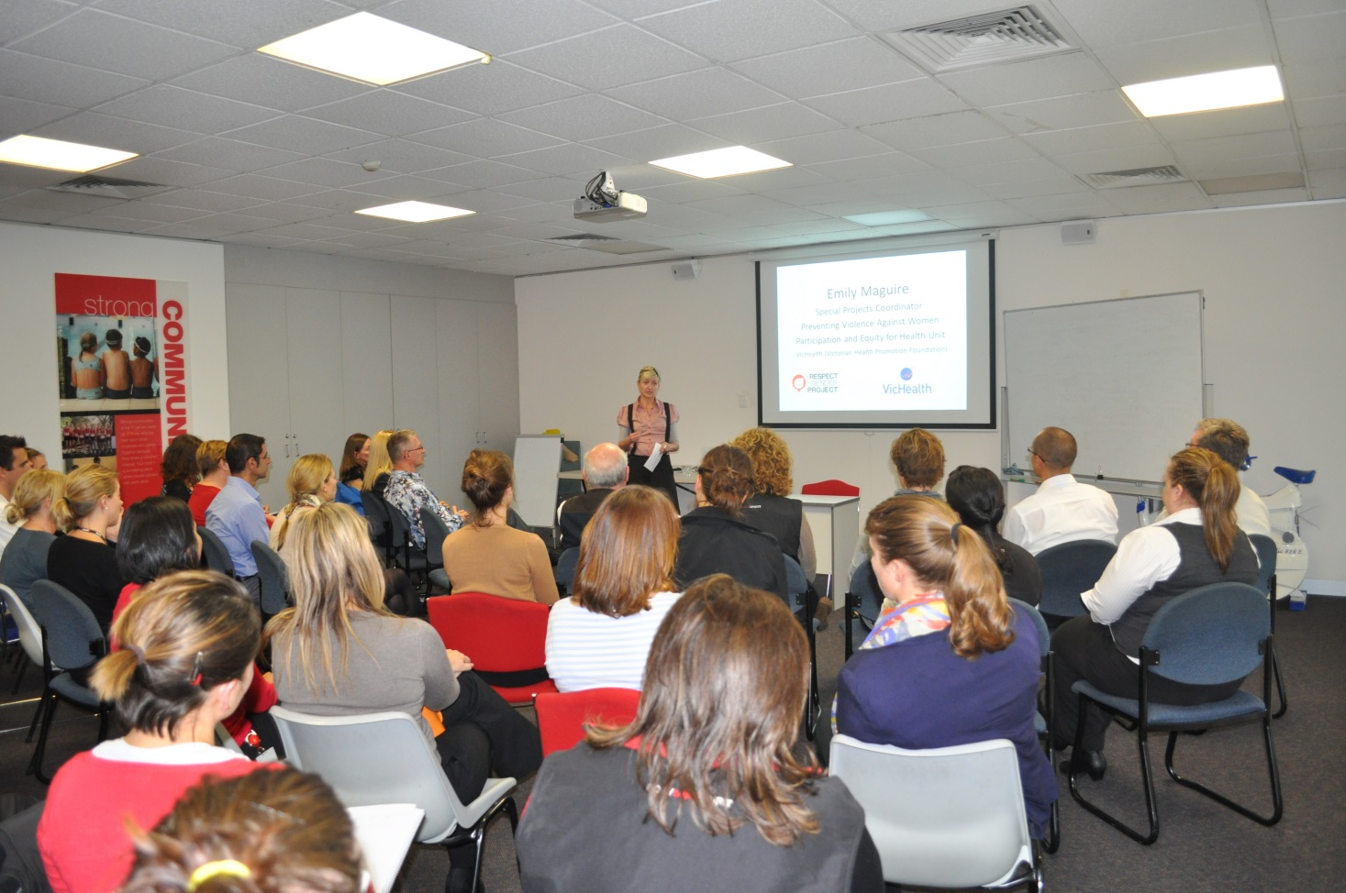

Slide 24
Y Respect Gender Project
Corporate capacity building
Action-learning pilot sites
Team based workshops – pilot sites, Children’s Services, youth volunteers, other
Leadership development (VH course)
Presentations to Board / Management
Communications and marketing
Policy and procedure
Learning and Development activities
HR procedures and compliance

Slide 25
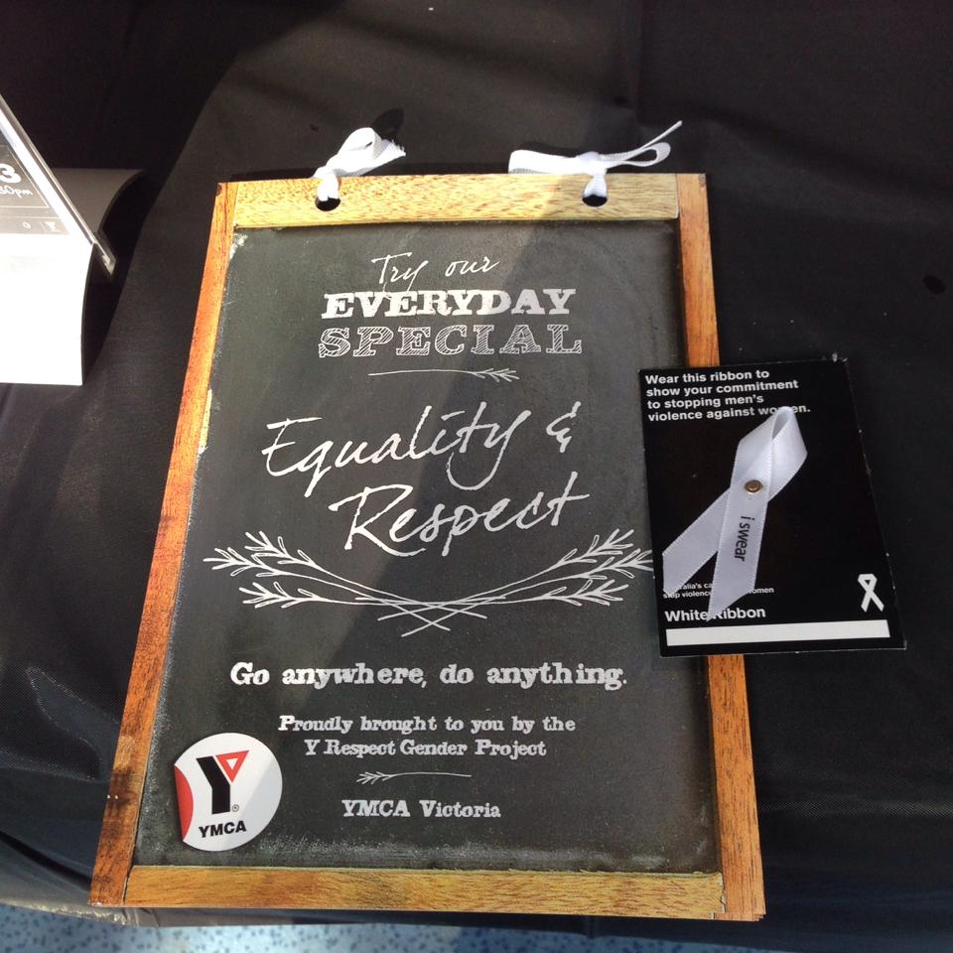

Slide 26
Gender is not a dirty word!
Sex and gender are not the same thing
Men have a gender too
Gender intersects with everything
Gender stereotypes impact men also
Gender inequality is a real issue
Gender stereotypes are everywhere
Gender inequality effects the people you know
(Gender inequality / stereotypes are social determinants for MVAW)

Slide 27
Pitfalls
Content of change creates an uneven appetite across the organisation
Every workplace is a multitude of stages / performances
Universal approaches have different impacts, targeted approaches are labour intensive
Competency for conversation about gender is generally low
Workplace gender performance intersects with performance in other places – home, society
Broader issues of how work is gendered across society

Slide 28
What are we seeing?
Change in awareness of gender at an organisational cultural level
More conversations
‘This is something we are doing’
What get’s noticed

Slide 29
What are we seeing?
Variability of readiness
Smaller sites with fewer staff
Children’s Services
Younger men
Men and women lower down the system
Men and women dealing with other workplace culture issues

Slide 30
What are we seeing?
Beginnings of integration into systems
Induction
HR procedures
Learning and Development
Risk and HSO
Informal mentoring

Slide 31
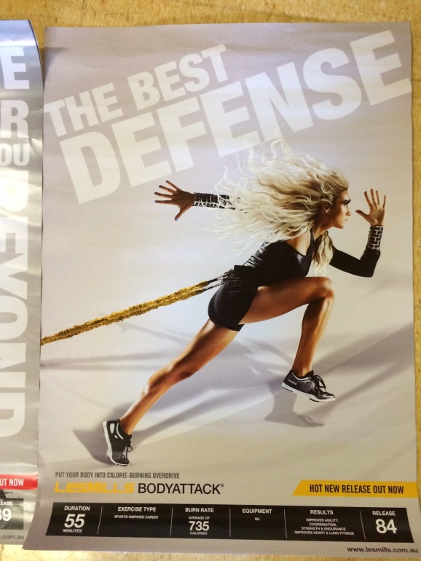
What are we seeing?
Specific examples
Children’s services staff
Posters
Competence / confidence
Inclusive practices
Guys

Slide 32
Hi Scott,
I often refer to a group of people including men and women to ‘Guys’. My daughter who is 9 also says ‘hey guys’ when she talks to her group buddies (who are all female).
Is ‘Guys’ and acceptable, modern way to address a group of men and women, girls or boys these days? Culturally it seems acceptable and not offensive.
Or is it better that we start to phase out this type of general grouping of people under context that maybe men are the dominant gender and everyone automatically forms part of that group?
I was about to send a message to my management team which includes two ladies, but altered the heading to ‘Team’ vs ‘Guys’… so my gender radar is on!
P.S. if you want to share this as an interesting staff news content, feel free to do so. The fact that we are talking about these things are a good sign your awareness program is working!

Slide 33
Conclusion
Workplaces are an important setting for primary prevention
Workplaces are complex settings
Importance of primary prevention initiatives reinforcing each other
Importance of focus on gender

