Slide 1


Vitamin D in pregnancy and breastfeeding
A/Prof Alexis Shub

Slide 2
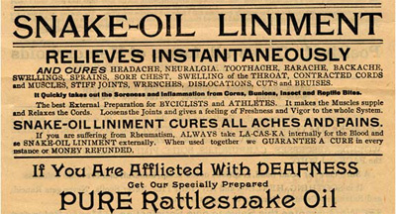
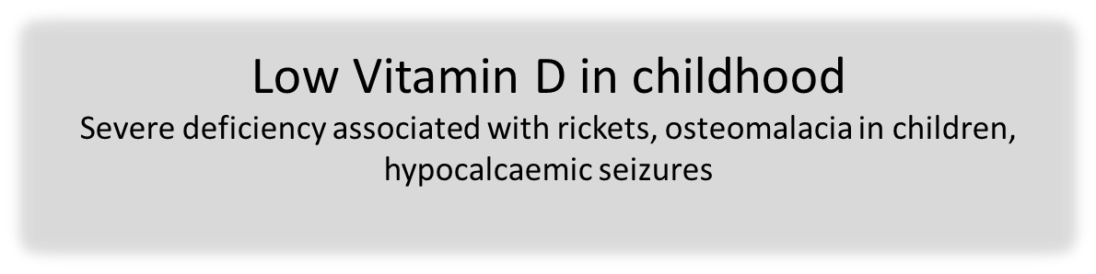
Vitamin D
Low Vitamin D in pregnancy is associated with increased risk of……
  bacterial vaginosis (Hensel AJOG 2011)
  severe preeclampsia (Baker JCEM 2010)
  cholestasis of pregnancy (Wikstrom Acta Obs Gyn 2010)
  gestational diabetes (Parlea Diab Med 2011) control of gestational diabetes (Lau MJA 2011)
  childhood eczema, wheeze and asthma (Camargo Paediatrics 2011)
  Type 1 diabetes (Sorenson Diabetes 2012)
  multiple sclerosis (Mirzaei Ann Neurol 2011)
  speech delay (Whitehouse Paediatrics 2012)
  schizophrenia (McGrath Schizoph Bull 2010)
  SGA (Bodnar J Nutr 2010)
  Macrosomia ( Morales Int J Obesity 2015)

Slide 3



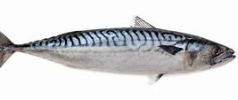
Vitamin D

Slide 4
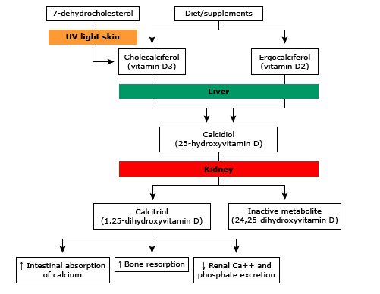

Slide 5

How much is enough?
>30 nmol/L
>50 nmol/l
>75 nmol/l
Or too much?
Or does it matter?
51% Vit D insufficient
Binkley JCEM 2007

Slide 6
The easy bits…
Low Vitamin D is common
Sunlight is a good source of Vitamin D
Low Vitamin D is associated with a wide range of poor health outcomes
Low Vitamin D /calcium in childhood can cause rickets or seizures
Nutritional rickets in Australia is almost always in children with dark skin
The harder bit…
Does Vitamin D supplementation in pregnancy lead to improved outcomes for women and babies?

Slide 7
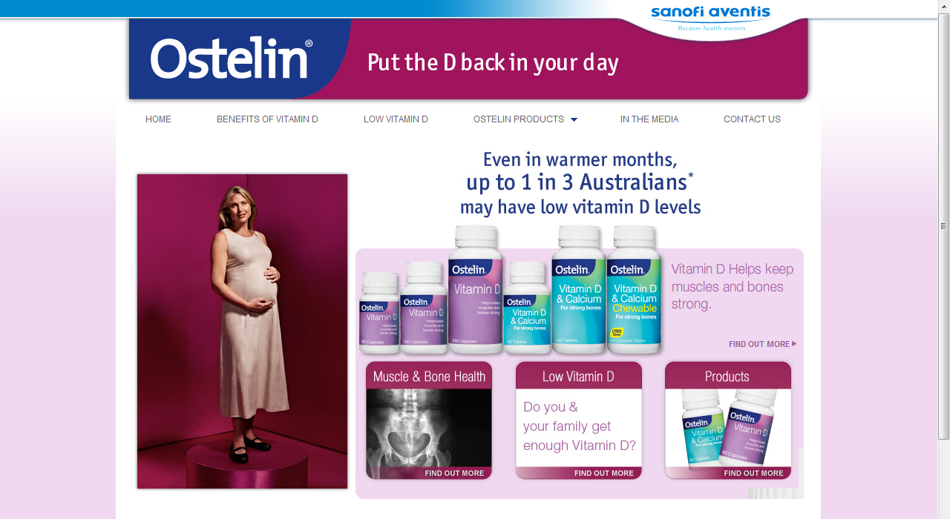

Slide 8

Early data: differences in GDM, preeclampsia, small babies, asthma
Concerns about rickets/bone density in children
What is the question?
How do we know the answer?

Slide 9

MAVIDOS:
UK
1100 women - low Vit D
Vitamin D 1000 iu per day or placebo
Primary outcome – infant bone mineral content
Cooper Lancet 2016

Slide 10
Roth:
Bangladesh
1300 women – low Vitamin D
Weekly Vitamin D from 17 weeks
Primary outcome – growth at 1 year
Postnatal
28,000 IU
antenatally and postnatal
High dose:
16,800 or
28,000 antenatally
Low dose:
4200 IU
antenatally
Placebo
New England Journal of Medicine 2018

Slide 11
Roth 2018
Bangladesh
1300 women – low Vitamin D
Growth at 1 year – no difference
Obstetric outcomes – no difference
Postnatal
28,000 IU
antenatally and postnatal
High dose:
16,800 or
28,000 antenatally
Low dose:
4200 IU
antenatally
Placebo
New England Journal of Medicine 2018

Slide 12
Vitamin D supplementation during pregnancy – outcomes for the baby

Slide 13
Vitamin D supplementation during pregnancy – outcomes for the baby

Slide 14
Vitamin D supplementation during pregnancy – outcomes for the baby

Slide 15
Vitamin D supplementation during pregnancy – outcomes for the baby
Roth NEJM 2018

Slide 16
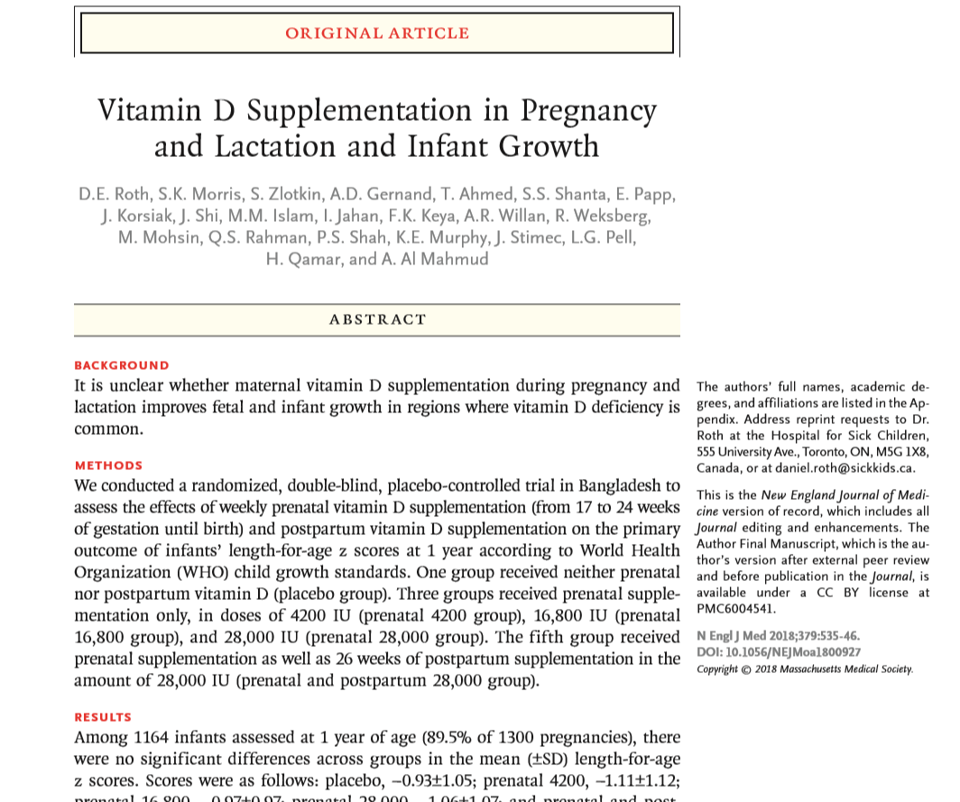
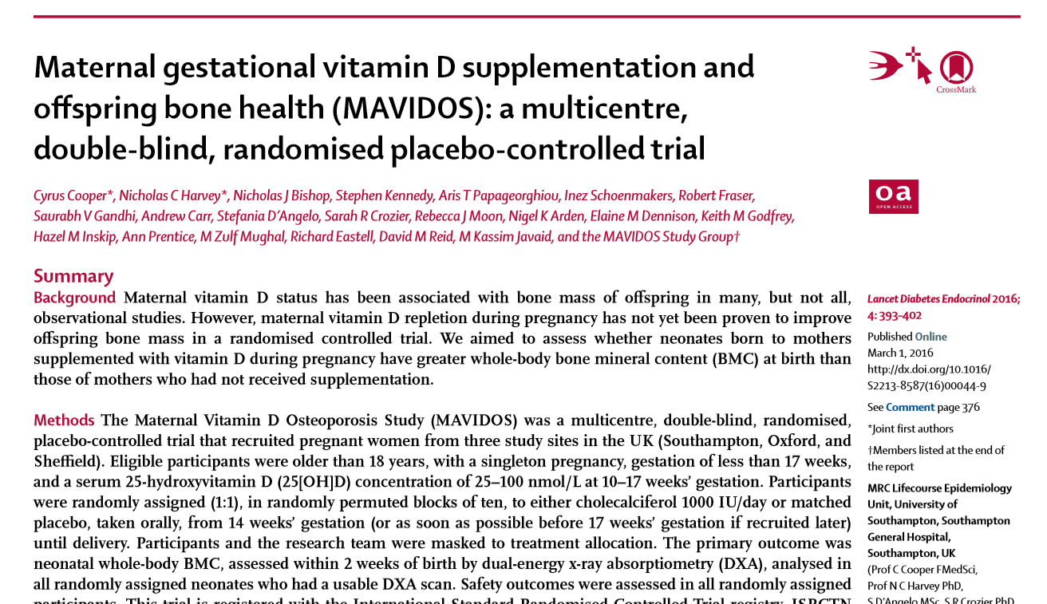
No benefit to maternal or neonatal outcomes from maternal antenatal Vitamin D supplementation

Slide 17
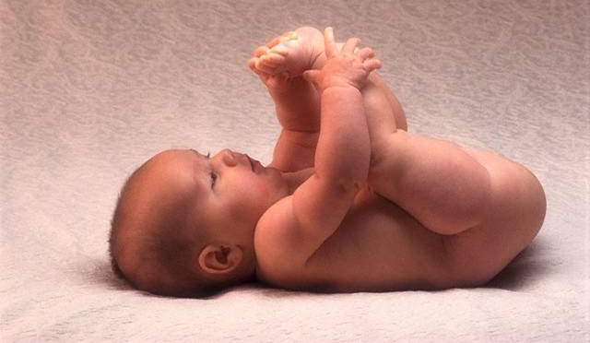
US : ”Any breastfeeding infant, regardless of whether he or she is being supplemented with formula, should be supplemented with 400 IU of vitamin D” AAP Wagner Paediatrics 2008
UK : Safe Intake range of 340-400 IU/d is recommended for all infants, including those who are exclusively breast fed and those who are breastfed and part-formula-fed, from birth. Vitamin D and Heath Scientific advisory Committee on Nutrition 2016
Safer care/RCH

Slide 18
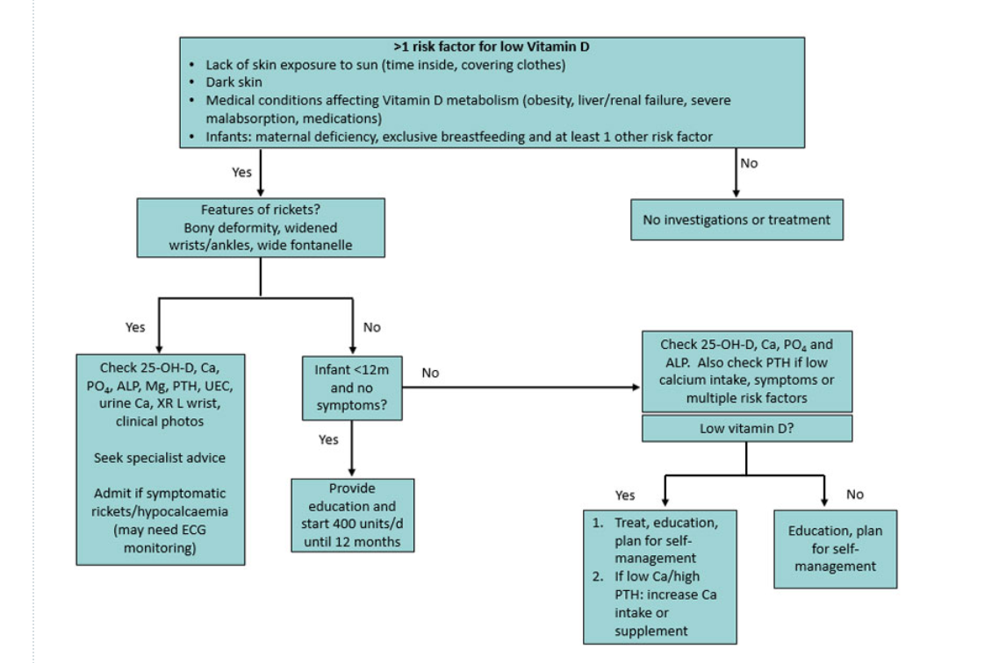
https://www.rch.org.au/clinicalguide/guideline_index/Vitamin_D_deficiency/ https://www.rch.org.au/kidsinfo/fact_sheets/Vitamin_D/
RCH Clinical practice guidelines Vitamin D

Slide 19
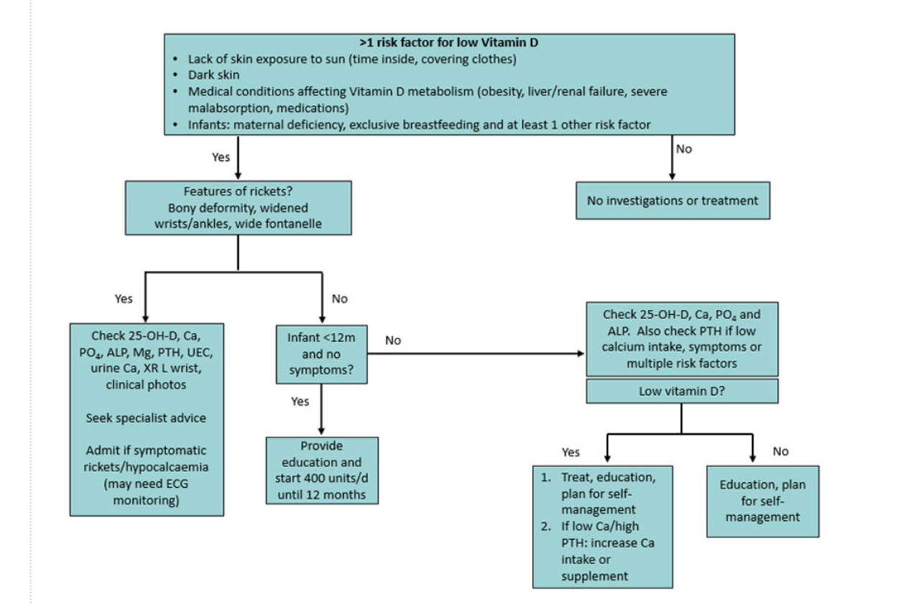
RCH Clinical practice guidelines Vitamin D
Exclusive breastfeeding
And
Lack of sun exposure or
Dark skin or
Maternal deficiency
Less 12 months and no symptoms: start 400 IU /day

Slide 20
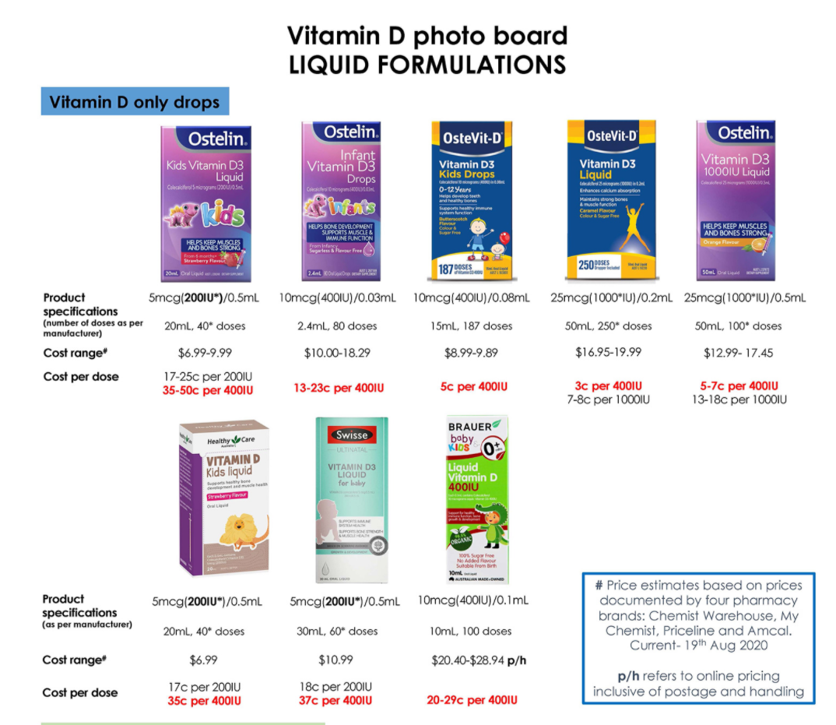
https://www.rch.org.au/immigranthealth/clinical/Vitamin_D_supplements_photoboard/

Slide 21
Why is there disagreement?
“High risk“ groups
  Poor relationship between risk factors and Vitamin D levels (Davies Tuck ANZJOG 2015)
  Trials in high risk women

Slide 22

Why is there disagreement?
“High risk“ groups
Asthma
Skeletal health for the post menopausal woman
  Bone density, muscle strength - increased
  Fractures – no difference
  Falls - increased
  Renal stones - increased
Brustad JAMA 2018 Litonjua NEJM 2020
Kahwati JAMA 2018, Zhao JAMA 2017

Slide 23
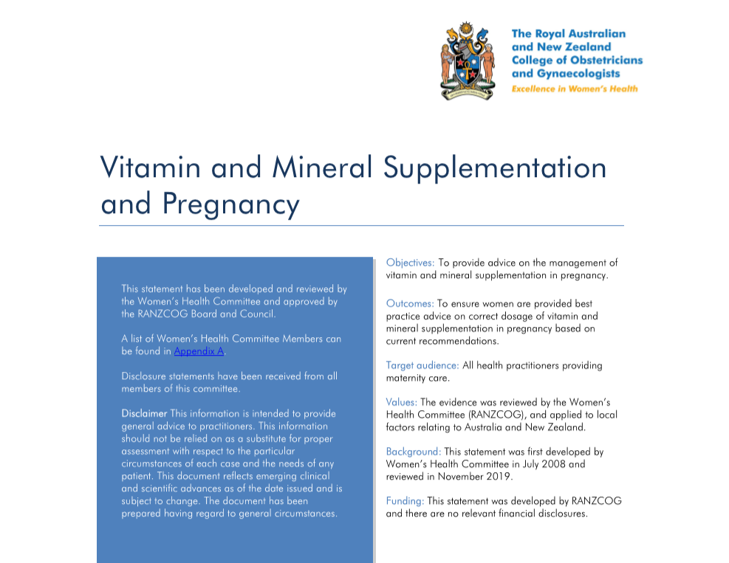
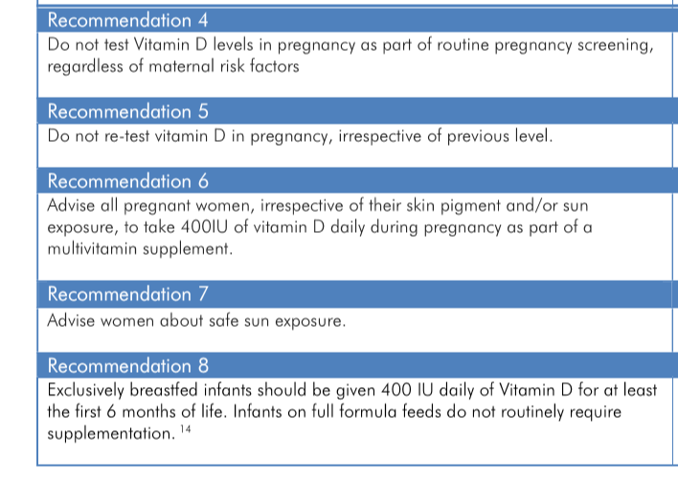

Slide 24
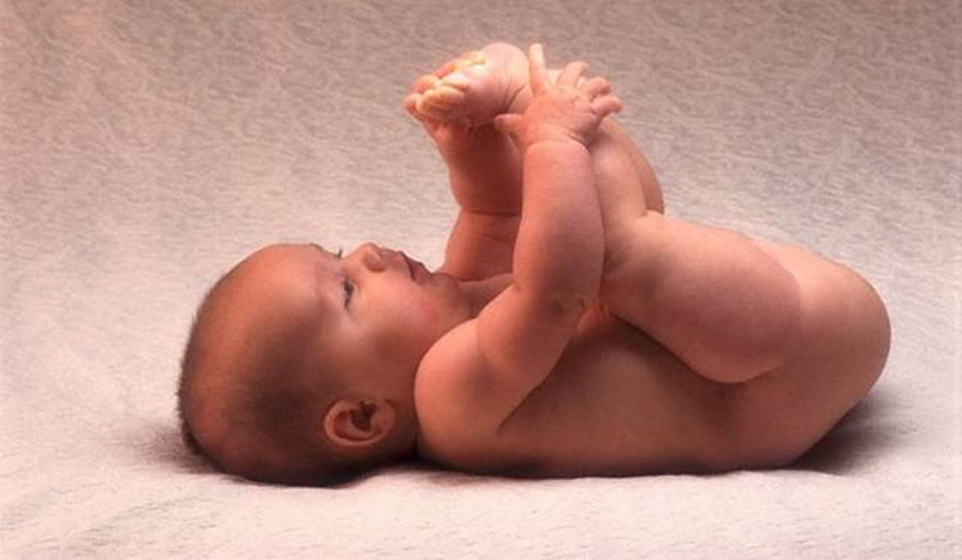
Vitamin D in pregnancy and infancy
Many women have low levels Vitamin D
There is no benefit in testing or supplementing Vitamin D during pregnancy – beyond a multivitamin
Breast fed babies should have daily supplementation of 400 iU Vitamin D

