Slide 1
CDIS Sleep and settling - outreach guide
December 2020

Slide 2
CDIS Sleep and settling – outreach guide
CDIS has been enabled with a range of additional capabilities to support specific “Integrated” programs that have:
the ability to link consultations and ‘Client Not Present’ records to cases
the ability to link multiple family members to the one case
the ability to select multiple family members as the clients of a single consultation
a Case Summary Screen to manage and update case management plans, including:
managing issues and goals
reviewing previous and upcoming consultations

Slide 3
CDIS Sleep and settling – outreach guide
Definitions:
Case – a program service delivery that has a start date and, when closed, an end date
Whilst a program is active (from start date to end date), consultations and ‘Client Not Present’ actions that are part of the program are attributed to that program.
Family enrolments, lead clients and non-lead clients
Multiple clients enrolled in the same case, called a family enrolment.
Lead clients must be the primary carer or carer of another client in CDIS
Non-lead clients must have a relationship with the lead client
Each case must have one lead client and can then optionally have any number of non-lead clients.

Slide 4
CDIS Sleep and settling – outreach guide
Clients can only lead one case of the Sleep and Settling - Outreach program at any given time, however they can be enrolled as non-lead clients in multiple cases of the same program simultaneously.

Slide 5
CDIS Sleep and settling – outreach guide
Referring a family:
Identify the related clients you wish to refer together into the Sleep and Settling – Outreach Program (this should be at least one child, and one parent/carer) and ensure they are related to each other and linked in relationships.
Access the client record of the client who will be the lead client (must be a parent/carer).
Open the Internal Referral screen (Clinical Activity > Referrals > + Internal)
Select Sleep & Settling - Outreach from the Program dropdown.
The referral screen will now have an extra section, called “Family included as part of this enrolment”. This section will list the lead client, and then all related clients. Click the checkboxes next to the names of all related clients you wish to enrol in this program as part of this case. If a family member is not listed here they are not linked in relationships.

Slide 6
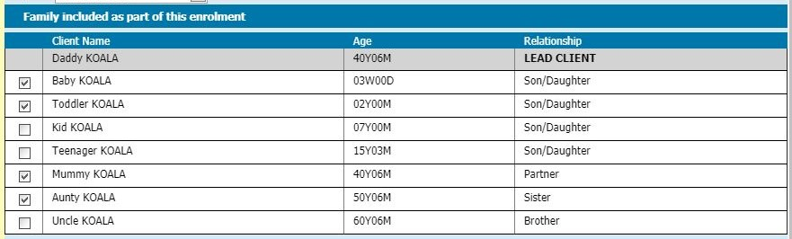
CDIS Sleep and settling – outreach guide
Which family members should I add to a case?
You should enrol any family members (both adults and children) who are actively involved in the goals of the case and are usually present at case consultations. In most cases, this will include one or two parent/carers and any children under the age of three.
Example:
Daddy Koala is the primary caregiver and has already been selected as the lead client.
Baby Koala is experiencing issues that are the reason for this enrolment, so they will be enrolled.
Toddler Koala experiences related issues, so they will also be enrolled.
Mummy Koala is working and not present during consultations, but will actively participate to meet the goals of the program.
Aunty Koala lives with the family and will actively participate in the behaviours necessary to meet the goals of the program.

Slide 7
CDIS Sleep and settling – outreach guide
Completing referral:
Complete the rest of the Internal Referral screen and click save
Program Active List:
Sleep and settling outreach staff and/or Team Leader/Coordinator will access the Programs Active List and follow current practice for accepting/assigning/declining referrals.

Slide 8
CDIS Sleep and settling – outreach guide
Managing a case:
The Case Summary Screen shows the details of a Sleep & Settling - Outreach case replacing the need to keep a separate document outside of CDIS.
Access the Case Summary Screen in the following ways:
Client record: Go to Client Details > Summary Screen> Programs section,
identify the relevant case, click the View link.
Access the Programs Active List: Use filters to search for the name of the lead client>click the Sleep & Settling - Outreach link.
Consultation Screen (Child Health Assessment): Open a new Consultation Screen for a lead client who is already active in a Sleep & Settling - Outreach case.
Select Sleep & Settling - Outreach as the Consultation Type.
Click the View Case Summary link, which will have appeared near the top of the screen.

Slide 9
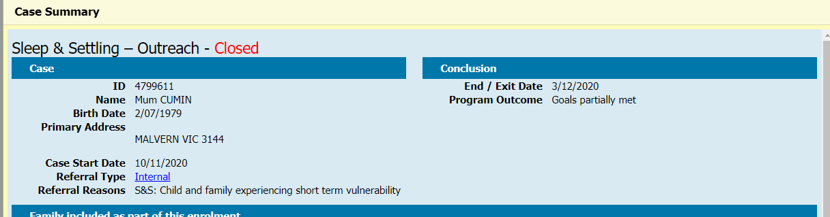
CDIS Sleep and settling – outreach guide
Case Summary Screen:
At the top of the Case Summary Screen it will say Sleep & Settling - Outreach and the case status; either Active or Closed.
The Case Summary Screen shows:
Case
Conclusion (only visible once case has been closed)
Family included as part of this enrolment
Issues
Goals
Case Delivery
Scheduled appointments (upcoming Program appointments, made with lead client)
Click the “Close” button at the bottom to save changes and return to previous screen.

Slide 10
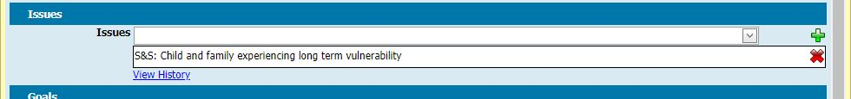
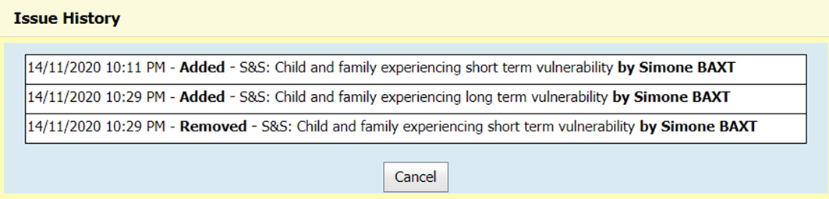
CDIS Sleep and settling – outreach guide
Issues:
The issues are the same as the Referral Reasons that can be added to an Internal Referral, and initially will be pre-populated with the Referral Reasons in the Internal Referral.
To add an Issue, select it from the Issues dropdown list and click the green plus symbol.
To remove an Issue, click the red cross.
To view a log of all additions and deletions from this list, click the View History hyperlink.

Slide 11
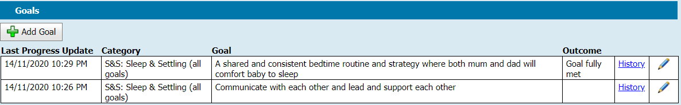
CDIS Sleep and settling – outreach guide
Goals:
Record the goals identified and agreed to in the Sleep and Settling Program Plan
To add a new goal, click the Add Goal button and a new Add/Edit Goal screen will popup.
To edit an existing goal, click the pencil icon on the right of the goal you wish to edit.
Once created, goals cannot be deleted, but all the fields within a goal can be edited.
To view a log of all changes to a goal, click the History link on the right of the goal.

Slide 12
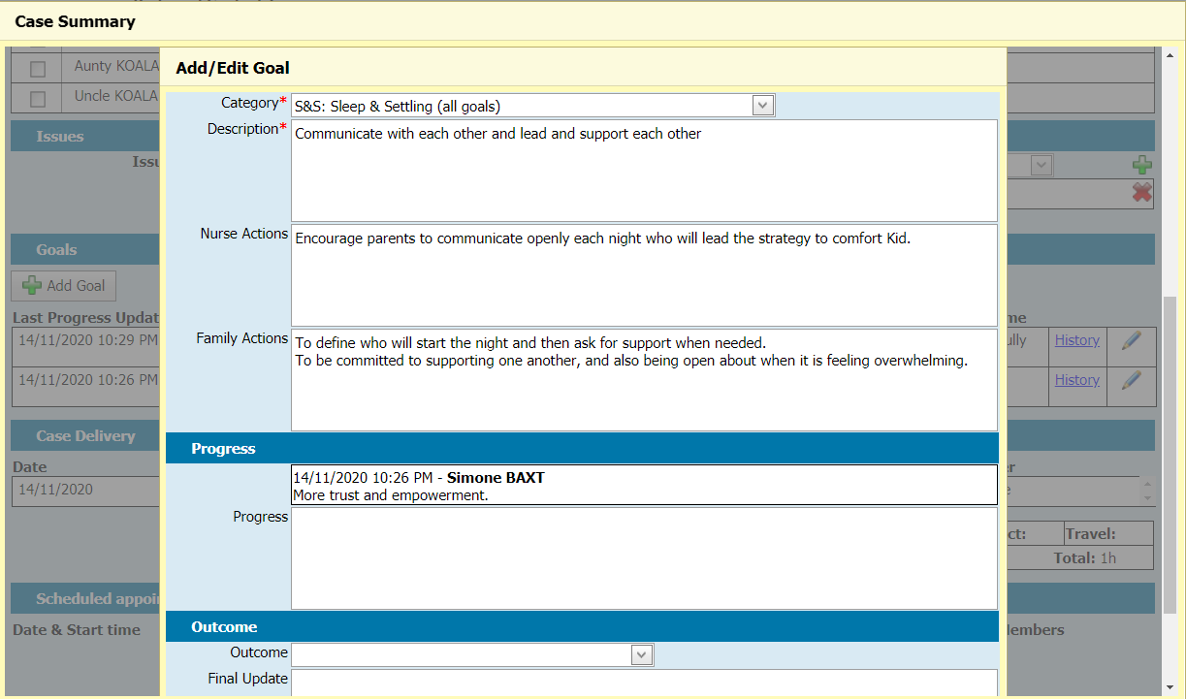
CDIS Sleep and settling – outreach guide
Category (Mandatory):
Sleep & Settling - Outreach has one single category . This is the first in the list and is prefaced with “S&S:”
Description (Mandatory): Where you should briefly describe the goal.
Nurse Actions: Actions that the nurse has agreed to undertake in pursuit of achieving the goal.
Family actions: Actions that the family have agreed to undertake in pursuit of achieving the goal.
Progress: Contain nurse notes on the progress that is being made towards the goal and is the main field that a nurse should use to update the goal.
Goals stepped out:

Slide 13
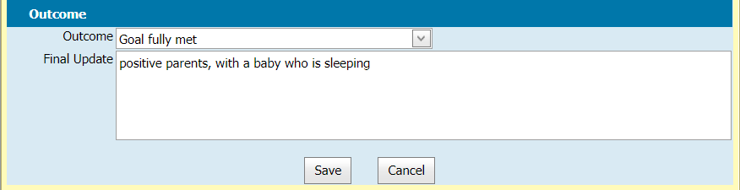
CDIS Sleep and settling – outreach guide
Goals Outcome:
Goal closure fields should be left blank until the goal is to be closed.
Outcome: This dropdown list contains three options. Goal fully met / Goal partially met / Goal not met.
Select the appropriate outcome when no further work will be undertaken on this goal.
Final update: Type your final update/summary here, when no further work will be undertaken on this goal.

Slide 14
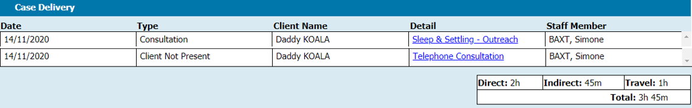
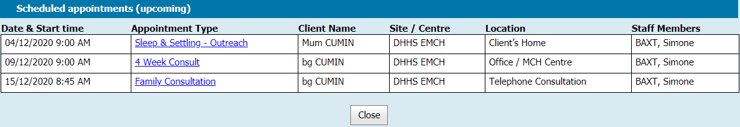
CDIS Sleep and settling – outreach guide
Case Summary:
Case Delivery - lists all completed consultations and ‘Client Not Present’ actions
To view the record of a completed consultation or ‘Client Not Present’ action, click the hyperlink
Shows the accumulated time spent on the case, Direct, Indirect, Travel, and the total of all three.
Scheduled appointments (upcoming)
Lists upcoming appointments for all clients linked to the case and is not limited to Sleep & Settling - Outreach consultations

Slide 15
CDIS Sleep and settling – outreach guide
Delivering consultations as part of an active case:
Sleep & Settling - Outreach consultations must be created against the lead client record of the Sleep & Settling - Outreach case.
Once completed, the consultation record will be recorded in the clients records of all clients (lead and non-leads) enrolled in the case.
Selecting the Consultation Type:
Once you have opened a new consultation screen (Child Health Assessment), select Sleep & Settling - Outreach as the Consultation Type.

Slide 16
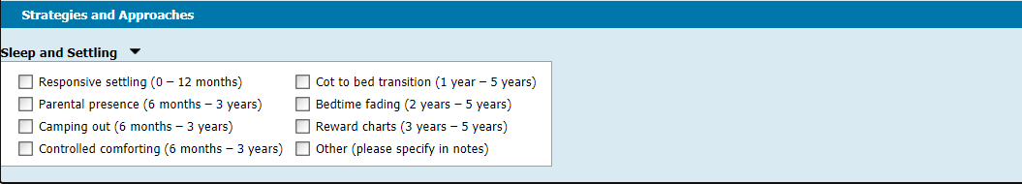
CDIS Sleep and settling – outreach guide
Strategies and Approaches:
When a Sleep & Settling - Outreach consultation type has been selected, this section will appear below the Assessment Details section. It contains the strategies that can be undertaken as part of a Sleep & Settling - Outreach consultation, as per the Sleep & settling mode of care.
The choices are listed under “Sleep and Settling”; click the black triangle to expand the list and see the options.
It is mandatory to select at least one option from this list when completing a Sleep & Settling - Outreach consultation.

Slide 17
CDIS Sleep and settling – outreach guide
Note:
If you wish to record information that:
relates only to a specific family member; AND
is not related to the Issues and Goals of this case
then that information should be recorded in a different consultation.
For example: If you wish to record Weight and Growth and/or Nutrition or complete internal or external referrals for the child you must open another Additional or KAS Consultation in the CDIS record of the child and complete the consultation. Ensure you save both consultations when you have completed each consultation.
DO NOT USE the weight and growth fields for data entry on the Sleep and settling outreach screen as the information will appear in the record of the Lead Client and not in the CDIS child record.

Slide 18
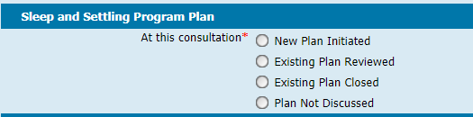
CDIS Sleep and settling – outreach guide
Sleep and Settling Program Plan:
Once the Sleep & Settling - Outreach consultation type has been selected, this section will appear above the Assessments / Interventions section and requires users to indicate the type of action that is being undertaken at this consultation.
New Plan Initiated: selected at the first consultation of a new case. Nurses should ensure that they undertake the necessary plan commencement activities as per program guidelines.
Issues and Goals can be recorded on the Case Summary Screen for this case, and other notes can be recorded within this consultation.
Existing Plan Reviewed: selected when a program plan is: being reviewed, amended or updated, renewed, and is expected to continue with further consultation(s).
Existing Plan Closed: selected when enrolment in the program will be closed at completion of consultation.
Plan Not Discussed: selected when an existing plan is being carried out, but is not being initiated, closed, or actively reviewed and renewed.

Slide 19
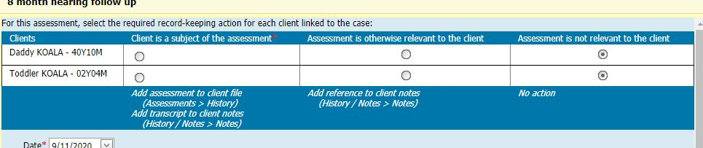
CDIS Sleep and settling – outreach guide
Assessments/Interventions:
When completing an Assessment Tool from within a Sleep & Settling - Outreach Consultation, the Assessment Tool will have an extra box at the top of the form. This box will list all clients linked to the case, and for each client, will allow the user to indicate how the Assessment Tool should be recorded against client records.
Client is a subject of the assessment: the Assessment Tool will appear in the client’s Assessment history (Assessments > History). A transcription will be added as a note in the client’s History / Notes. Generally this option is used for the subject of the Assessment Tool. It is mandatory that at least one client in the list has this option selected.
Assessment is otherwise relevant to the client: this will only add a reference to the Assessment Tool as a note to the client’s History / Notes.
Assessment is not relevant to the client: the Assessment Tool will not be recorded against the client’s record and is the default option for all clients in the list.

Slide 20

CDIS Sleep and settling – outreach guide
Next Program Steps:
This is below the Time section at the bottom of the Consultation screen.
Continue in program: should be selected program/ case is expected to continue with further consultations.
Exit from program: should be selected when the program enrolment / case will be closed
The case will be automatically closed, with an exit/end date matching the date of this consultation.
The case will be removed from the Programs Active List
When Exit from program is selected, a dropdown box will appear.
Program Outcome:
Goals fully met
Goals partially met
Goals not met
Select the option that best reflects the extent to which this program achieved or did not achieve the goals.

Slide 21
CDIS Sleep and settling – outreach guide
Delivering 'Client Not Present' actions as part of a case:
Time spent on a Sleep & Settling - Outreach case (outside of delivering a consultation) should be recorded in CDIS as a Client Not Present action.
The Program dropdown lists all programs that the client is currently enrolled in. Select Sleep & Settling - Outreach.
Complete all other fields as appropriate, then click save.
The Client Not Present record is recorded in the client’s Sleep & Settling - Outreach case.
Accurately record time taken for the direct, indirect and travel when delivering multiple consultations for the same client. Estimate the time taken for each consultation The total time for the consultations contribute to the delivered hours for that case.

Slide 22
CDIS Sleep and settling – outreach guide
Transferring clients between service providers:
Programs and cases cannot be transferred between service providers.
When a client is transferred to a different provider, their involvement in any active Sleep & Settling - Outreach case will end and case will be closed with end date.
Warning:
If a client record is temporarily transferred to a different service provider before being transferred back again:
For a lead client, the case will have closed and will need to be reopened.
For a non-lead client, they will need to be re-added to the active case via the Case Summary Screen.

