Slide 1
Child Development Information System (CDIS)
CDIS Clinical Users Group
Thursday 9th February 8:30 am – 9:30 am

Slide 2
Contents
Tips and Tricks
Updating Addresses
Caregivers and information sharing
Information Sharing process – receiving a IS request
Q&A

Slide 3
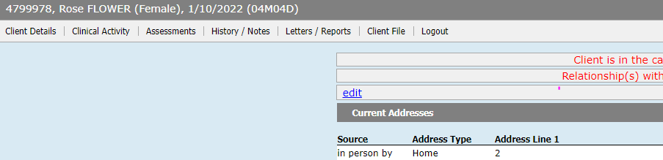
Tips and Tricks
Open/Change/Close Client – ensure that children and all relevant relationships are open for service as per clinical judgement.
When booking Home Visit in calendar add a note with the babies DOB/CDIS # so that it can been seen in the appointment screen.
Best practice when recording pronunciation of names please place in edit tab on front page not as part of the name as this is a medical record:

Slide 4
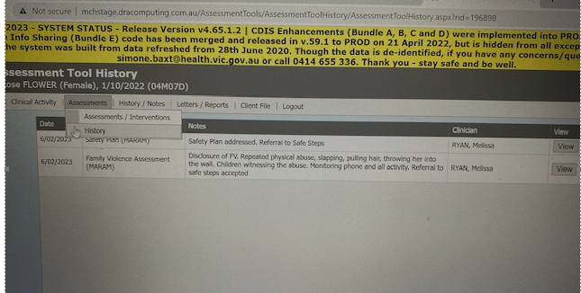
Tips and Tricks
When searching CDIS notes for certain information you can use the filter or use the Assessments Tab – History to find the most recent assessment eg.:

Slide 5
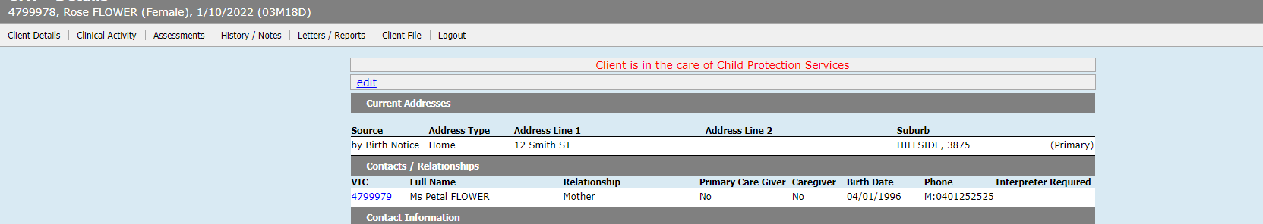
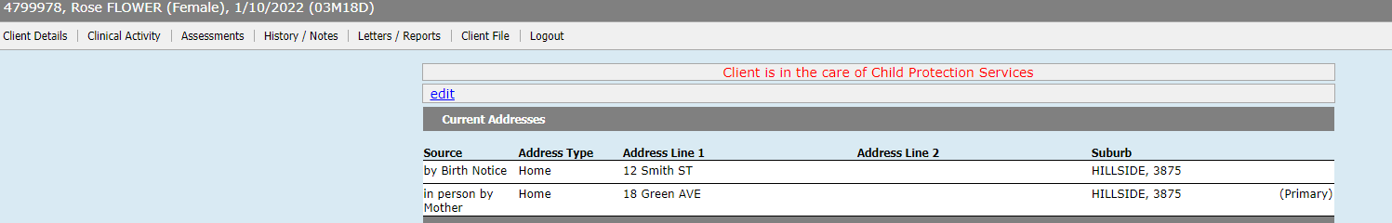
Updating Addresses
When PCG gives a new address please do not tick change for all family members as this will delete the history of addresses
Adding separately to each family member ensures that address history remains. This is important for information sharing and identifying families. New address Green Ave.

Slide 6
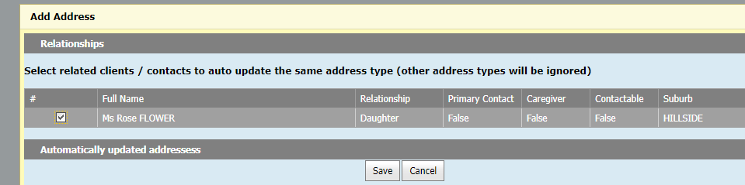
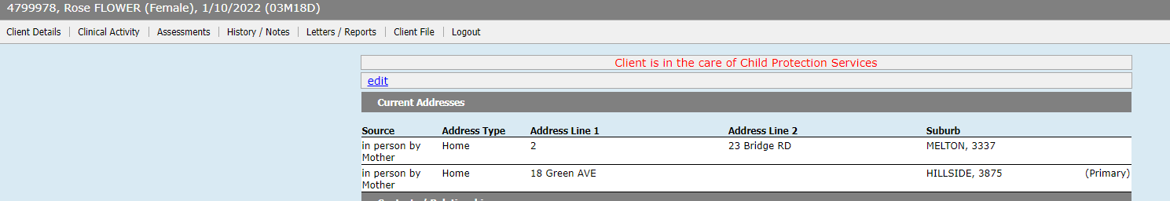
Updating Addresses
If you click yes to the following when updating the new address:
Addresses from the family members history will be deleted and does not update the primary address
As you can see the Smith street address has been deleted and the primary address stays at Green Ave, not to the new Bridge Rd address.

Slide 7
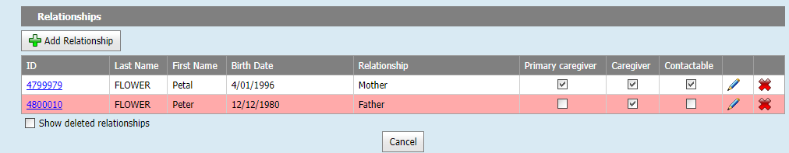
MCH Clinician role to review relationships and information sharing status
Admin team enter mother due to Birth notice and tick as PCG and contactable.
Admin team may add other family members putting no to information sharing.
Responsibility of MCH practitioners to discuss with PCG re family relationships, caregiver and contactable status.

Slide 8
Information Sharing Processes – Receiving an information sharing request
First ensure the ISE is verified, if it is also RAE, if request is for assessment purpose by:
    Immediate call back to confirm organisation: or
    Requesting an email for ISE to verify organisation credentials in email signature
Best Practice - ensure that sufficient information is provided by the ISE requesting information so that you can make a clinical decision regarding your response and information shared. See information sharing checklist resource.
Record Information Sharing (IS) request on CDIS

Slide 9
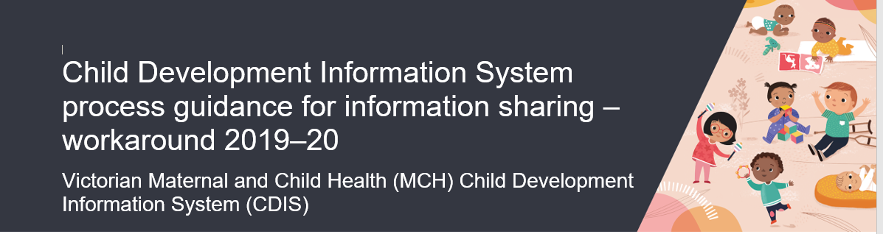
CDIS processes: receiving a request
Place IS request in the appropriate CDIS record – ie for the safety of the child place in the child’s CDIS record.
Process as per 2019-20 process guide:

Slide 10
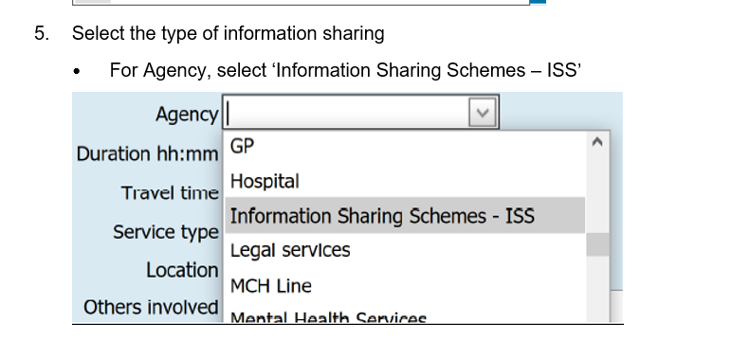
CDIS processes continue: receiving a request
According to the above document the recommended procedure is to select Agency as - ISS as shown below (this was to indicate information sharing under the scheme)
The details of the ISE requesting the information to be free typed into the others involved.

Slide 11
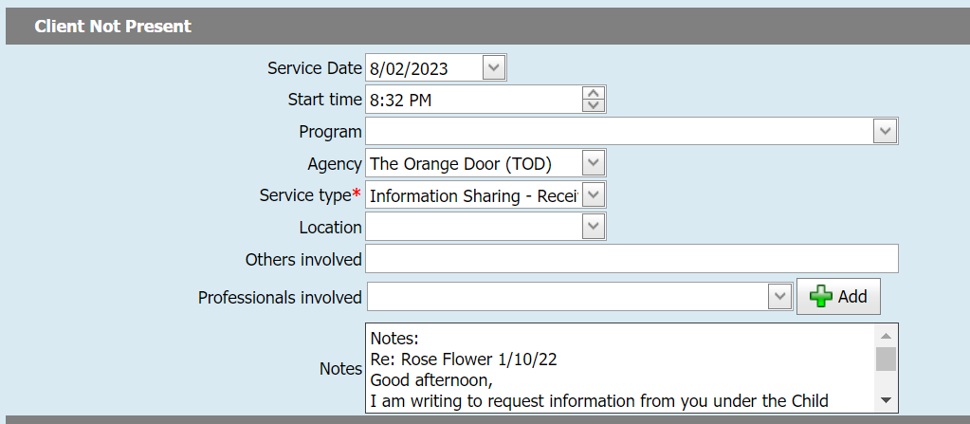
CDIS processes continue: receiving a request
Alternatively the agency can be selected from the drop down box. This appears to be the more common method of recording IFS requests:
Paste email into the notes

Slide 12
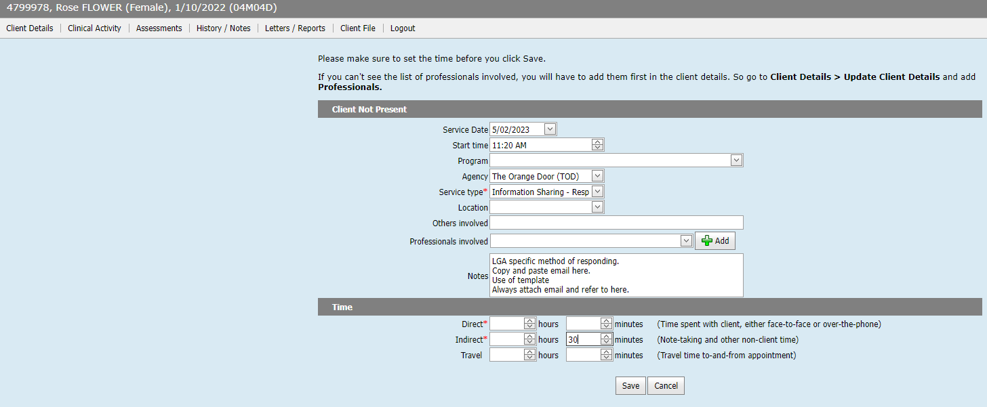
CDIS Process continued: Responding to a request
LGA specific method of responding.
Copy and paste email here.
Use of template is optional.
Always attach email.

Slide 13
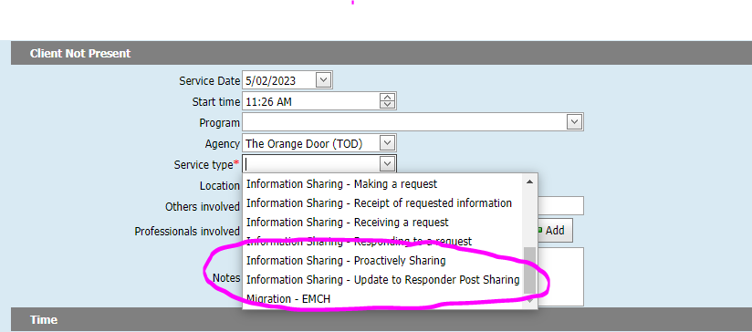
CDIS processes: Proactively sharing or update to responder post sharing
You can use these options if information is shared post the initial information sharing

Slide 14
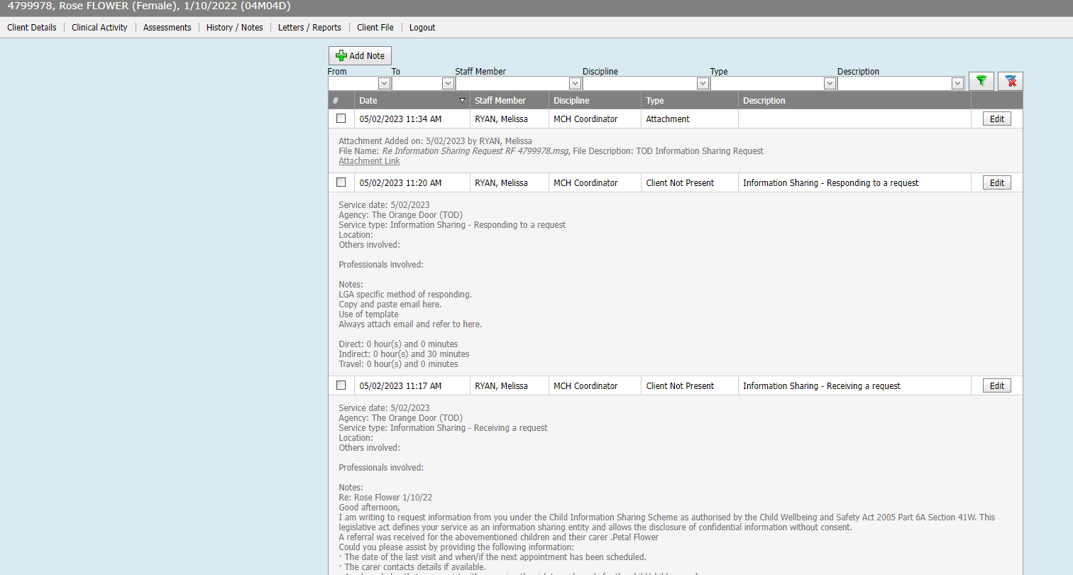
CDIS Notes view

Slide 15
Process continue:
Information sharing request to be included in primary caregivers history also.
Attach email correspondence
Adding to the primary caregiver history provides a history of IFS requests and risk.
Add flags as required
Follow up appointments as required
Unable to pull a report from CDIS to capture the increasing work in this space.
Some councils are tracking their own IFS requests for data and follow up.

Slide 16
Information Sharing Resources
https://www.health.vic.gov.au/maternal-child-health/child-development-information-system?rid=196458
CDIS process guidance for Information Sharing workaround
https://www.mav.asn.au/what-we-do/policy-advocacy/social-community/children-youth-family/maternal-and-child-health-children-0-6-years/Information-Sharing-and-MARAM-Reforms
MAV Information Sharing for MCH services. Correspondence templates and supporting tools.

Slide 17
Reminders and Q&A
Follow the CDIS processes as these have been developed and tested for best practice and to ensure accurate reporting.
Data collection is an important part of our service for funding and trends.
Your questions, thoughts and discussions☺
Next slide for response to questions:

Slide 18
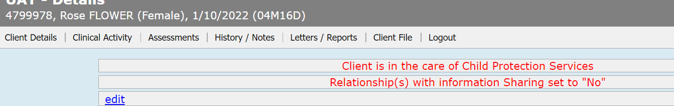
Q & A
What does Relationships with Information Sharing set to “N0” mean on the client file:
What that relationship Sharing set to No means is:
This pop up means that there is relationship to this client who has information sharing set to no.
Please review relationships before sharing information.

Slide 19
Q & A
Fathers with a new baby, can their history be pulled from the previous council?
Histories should only be transferred following a conversation with the family about the relevant histories of the family group in the new LGA - don't make assumptions and transfer histories (partner or children) without knowing the circumstances?
Passwords for CDIS resource and vimeos. See in attached email.
What is the purpose of the time recording at the end of a consult?
This is recommended as best practice. Whilst some things currently can't be extracted in a report - All entries into CDIS have the ability to be added to reporting in the future, time in universal consultations being one of them?
These time entries are recorded on the Integrated Programs (EMCH/Sleep & settling) Reports.

