Slide 1






EMCH Drop in sessions
September 20 & 27th 2023

Slide 2
Follow up from EMCH webinar
Any questions or topics you would like me to go over or discuss further
Notes:
I have the slides available to share and use again.

Slide 3

How can I check my EMCH Case load?
CDIS home page
General
Programs Active List
Program: Enhanced MCH
Site: All
Clinician: your name
View
Search
Print List (option)

Slide 4
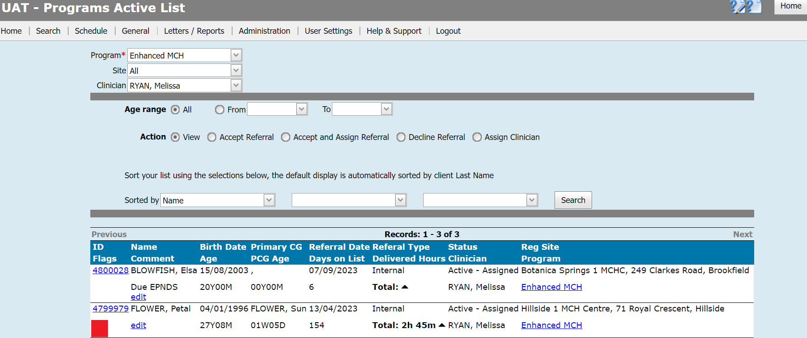

Slide 5
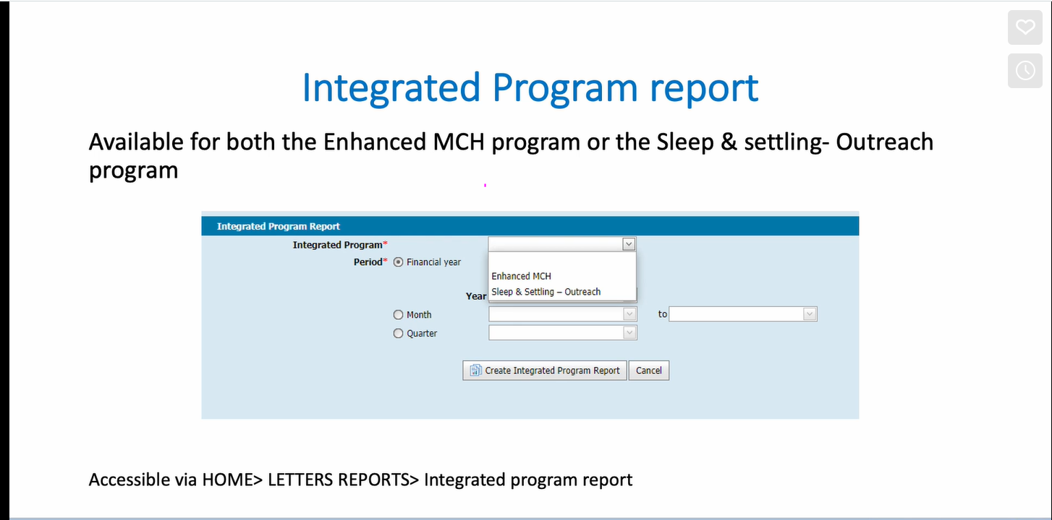
Integrated Programs Reporting - EMCH
Notes:
How to run a EMCH report

Slide 6
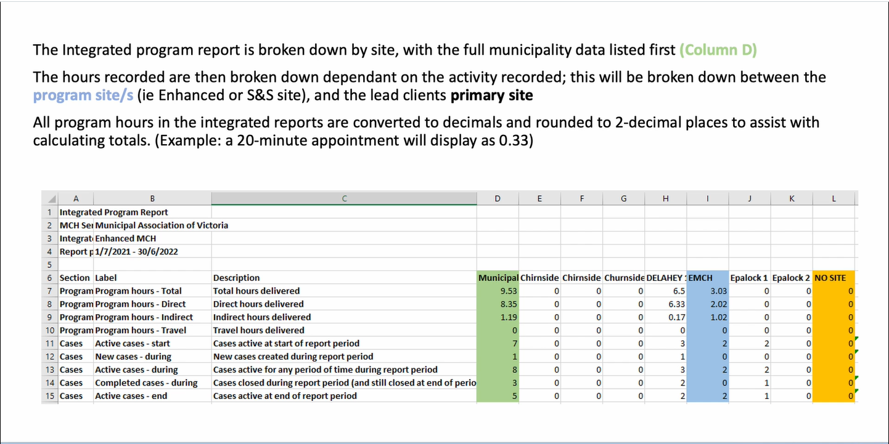
Notes:
This is what a report looks like

Slide 7
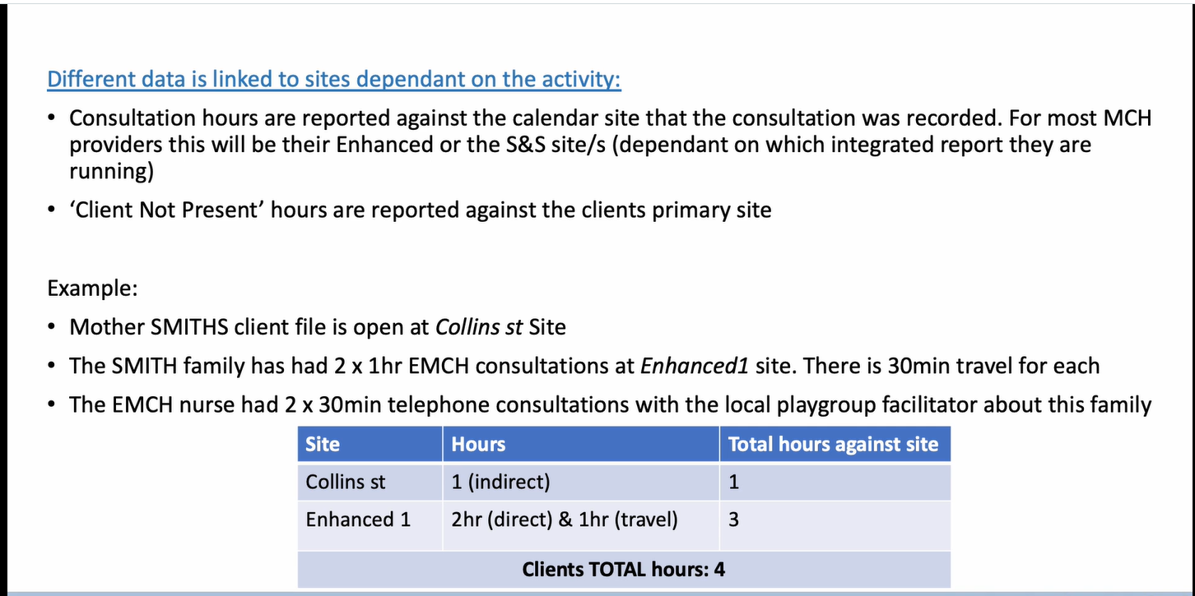

Slide 8
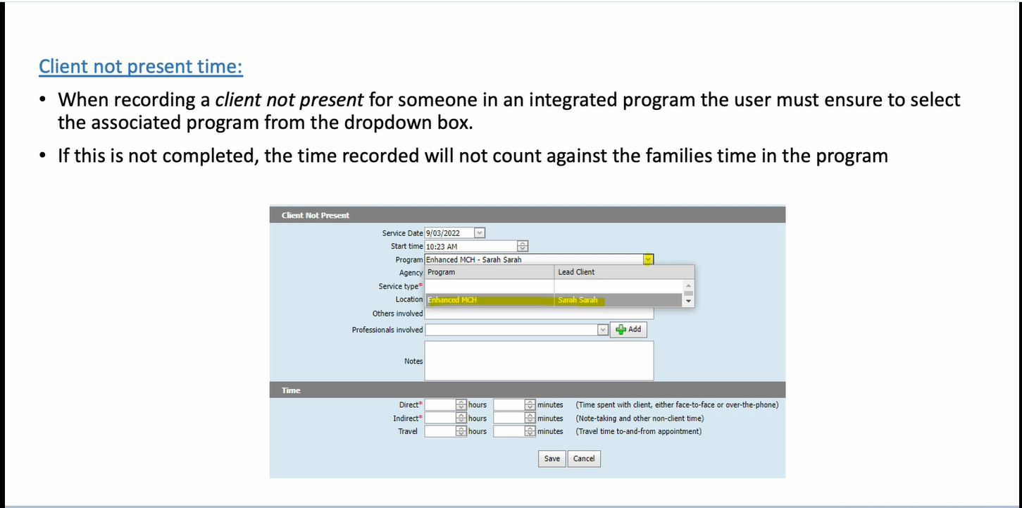

Slide 9
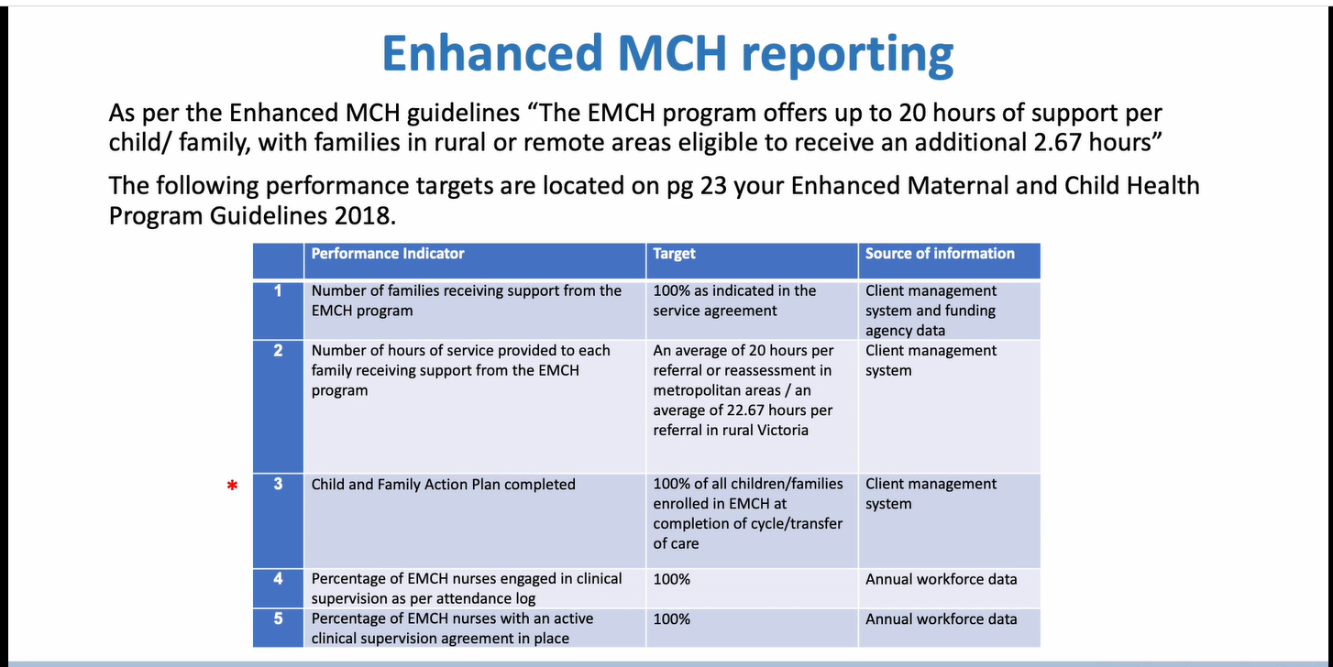
Notes:
Integrated report covers performance measures 1 and 2.
All reporting requirements will be included in the new system – we don’t anticipate any additional reporting to be added to CDIS.

Slide 10
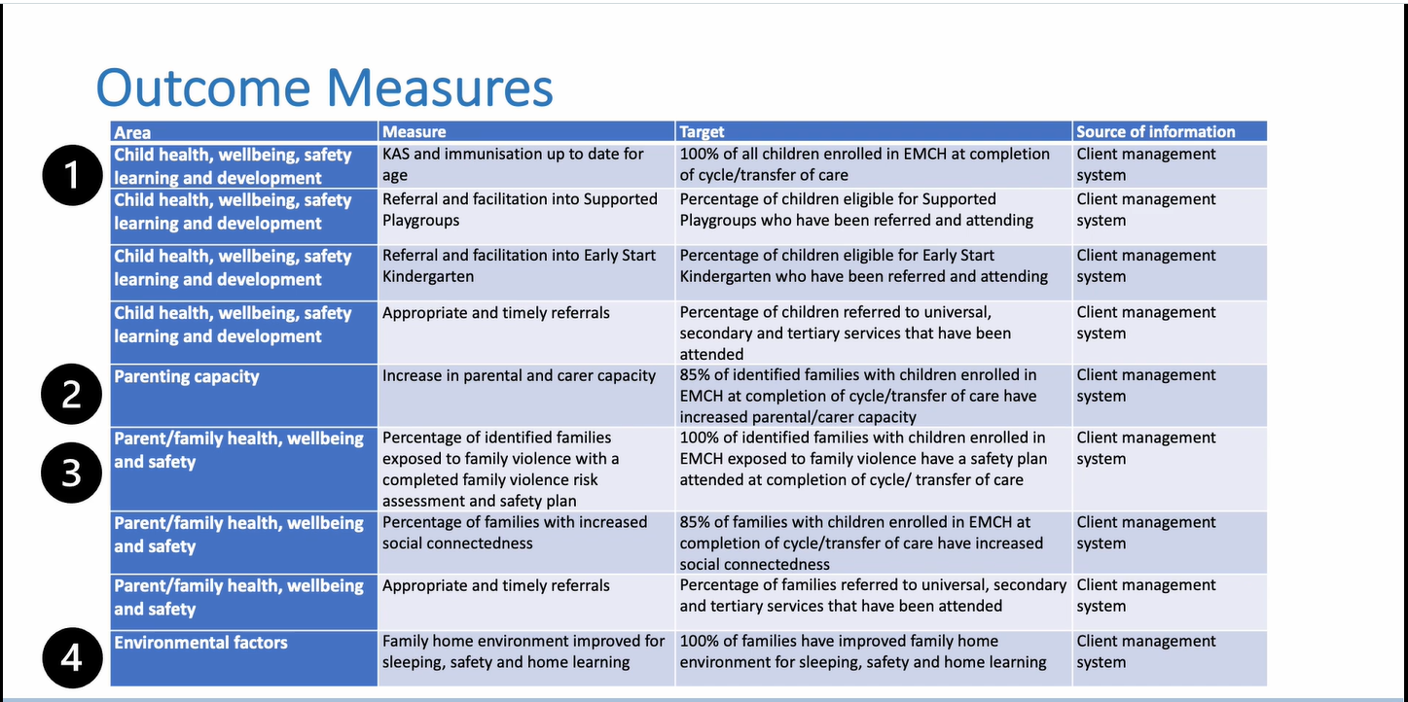
Notes:
Outcome measures for children and families are measured in the 4 key areas outlined here. These are reflected in the families' goals established in the CFAP
Each LGA is required to monitor and collate these outcome measures.
PG 24 EMCH guidelines

Slide 11
Area of need | Need/risk factors | EMCH intervention outcomes
Child heath, wellbeing, safety, learning and development | Premature infants and failure to thrive Complex feeding or sleep issues Children with poor social or emotional wellbeing (e.g. withdrawal, anxiety, behavioural issues, delayed communication, symptoms of trauma) Children with a developmental delay or disability Children with chronic health conditions (often with multi-medical co-morbidities) Children with serious injury due to falls, accidents, assault, accidental poisoning and intentional self-harm | Earlier detection of health, wellbeing, learning and developmental issues Improved physical health Improved social, emotional, language and cognitive development Better access to early childhood services
Parenting capacity | Significant parent-child bonding issues Inadequate parenting skills (e.g. warmth/ nurturing, ability to provide home structure, communication) | Improved relationship between parent/ carer and child Improved parental knowledge, skills and confidence Improved home environment (and improved parental capacity to provide a positive home environment)
Parent/ family health, wellbeing and safety | Parent is not able to keep the child in mind most of the time Parent mental health issue (e.g. mild anxiety and/or depression) Parent with an intellectual or physical disability Parent with a chronic illness/ unexpected illness Parent with mild drug, substance or alcohol issues Financial distress, low income or partner unemployed History of trauma having a current family impact Parent affected by family violence Families currently known to Child Protection or currently have a child in kinship or Out-of-Home care Recent relationship breakdown/ separation Contested custody/access to infant/ child Social or geographical isolation Housing issues or homelessness | Parent able to keep the child in mind Improved parental health and wellbeing Family environment free from conflict or violence Better access to adult services and supports Reduction in social isolation and stronger linkages to community
Environmental factors | Unsafe sleep and home environment Lack of home learning environment | Assessment and interventions to improve sleep, home and learning environments.
EMCH Guidelines (2017) Appendix 3
Notes:
Child and Family Outcomes – Appendix 3 in the EMCH guidelines.
Linking the outcome goals to the risk factors.

Slide 12
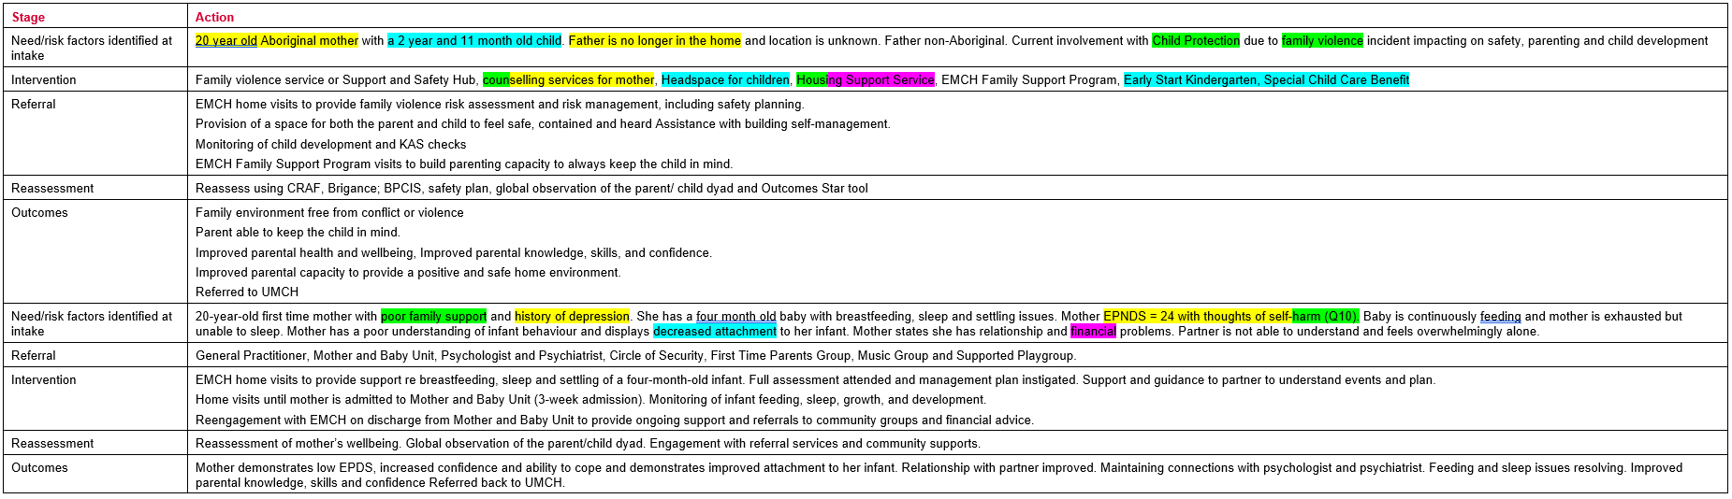
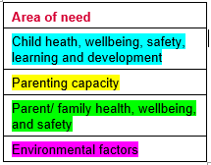
Case Scenarios – EMCH Guidelines Appendix 5
Notes:
Just to demonstrate the area of needs/risks how they align with the goals/outcomes.

Slide 13
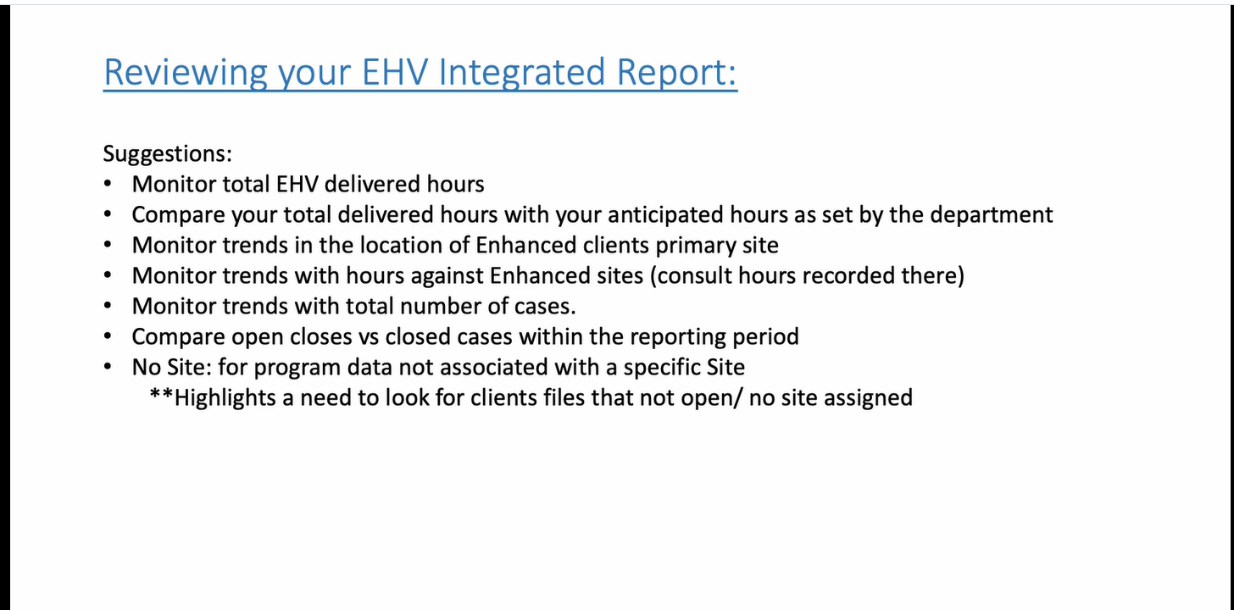
Notes:
Just some ideas – this is more directed at Leadership but very aware for regional and rural EMCHN will be doing this and analysing the data

Slide 14
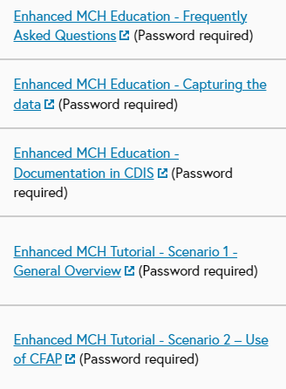
Resources
MAV MCH Resource page EMCH Education and New reports vimeos (password cdis)
https://www.mav.asn.au/what-we-do/policy-advocacy/social-community/children-youth-family/maternal-and-child-health-children-0-6-years/maternal-and-child-health-resources#top
Enhanced MCH Program Guidelines https://www.health.vic.gov.au/publications/enhanced-maternal-and-child-health-program-guidelines
CDIS Enhanced MCH Guide https://www.health.vic.gov.au/maternal-child-health/child-development-information-system?rid=212753
Notes:
Also referencing the EMCH education Vimeos on the MAV MCH Resource page website
These are a great resource for orientating new EMCH Team members

Slide 15

Lastly, I just want to acknowledge the valuable work you do every day with families facing vulnerabilities. It is important to remember to meet the family on their journey. With your experience you may be able to see what supports families need but remember they may not see what you see – goals should be established in partnership with the family identifying their own needs.
Don’t underestimate the small things you do every day:
The connection you make with the family
The role modelling when making eye contact and talking to a baby; playing and interacting with a toddler.
Remember you may be the best experience this family have that day.

