Slide 1
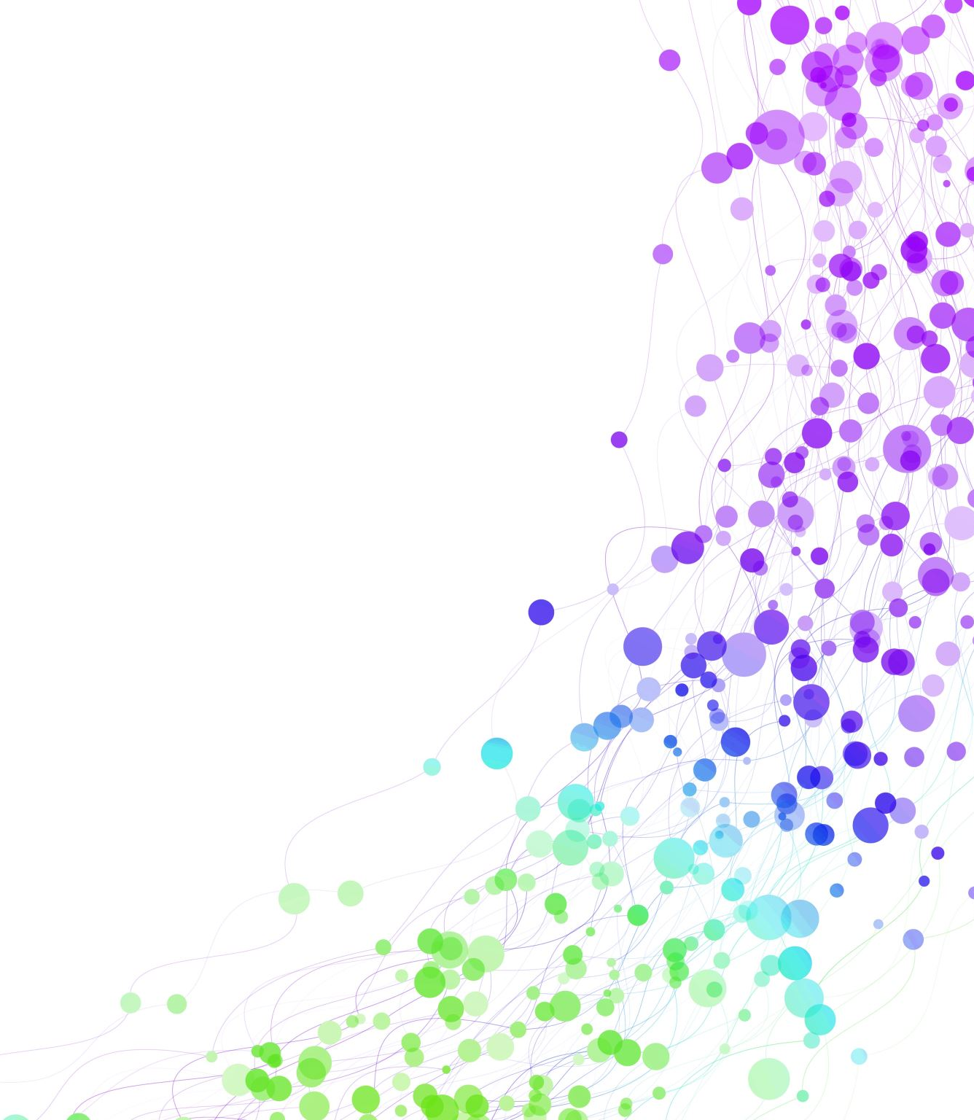
Child Development Information System (CDIS) CDIS Clinical Users Group
Thursday 15th February
8:30 am – 9:30am

Slide 2
Contents
Tips & Tricks Assessment History Notes in Assessments for MARAM screening Appointment Reminders – SMS Refresh
Correct way to record DNA
How to check DNAs for my clients and for my center
Adding Email to Signature Block
Appointments Allocations function/Screen
Q&A

Slide 3
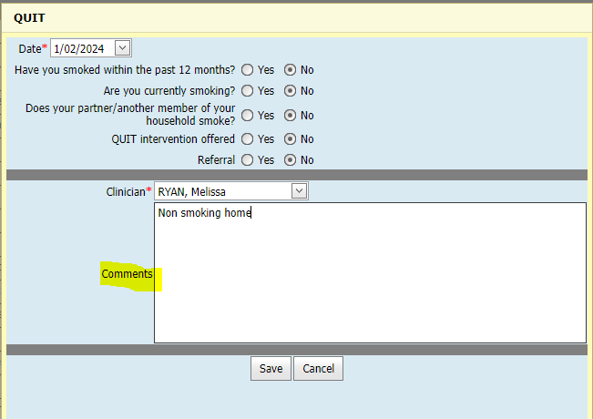
Tip: Using the Comments section in Assessment Tools
Best Practice is to complete a note in the comments section of the assessment tool you select in CDIS
This note can be viewed on the Assessment Tool History screen.
This is a good way to get an overview of the assessments attended.
Even when the assessment is NAD, declined or denied enter this into the comments then the next clinician will not need to search through the notes for the outcome of the assessments.
The Assessment Tool History screen is a great tool for Information Sharing
Another tip is to note referral attended in the assessment comments this will also help referral follow up.

Slide 4
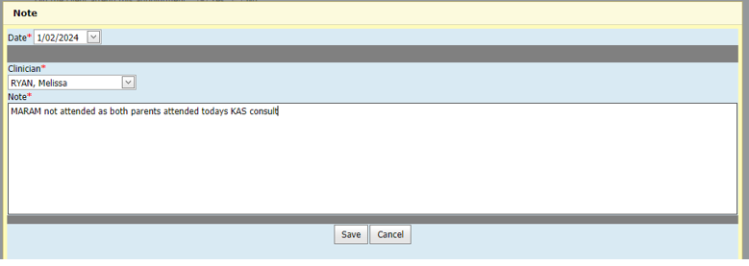
Tip: Using the notes assessment from within a consult
Using the note assessment within the consult is an easy and efficient way to record something that you want noted in the notes outside of the consult.
Eg Recording MARAM not attended as both parents attending the KAS consult.

Slide 5
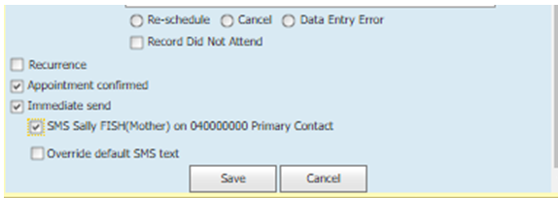
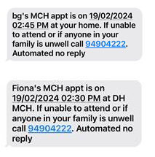
Appointment Reminders
SMS Templates are set centrally (state-wide) for all MCH services. There are several SMS templates, each for different types of messages.
right click and “edit” the appointment for this client,
click in the immediate send checkbox,
click in the checkbox to “SMS the caregiver….” and then
click in the check box to override the message, you will see the template, copied here below for ease. (you can click cancel to close out of this now, if you don’t wish to make any change to the SMS template).
[ClientFirstName]'s MCH appt is on [AppointmentStartDate] [AppointmentStartTime] at [SiteName].
If unable to attend or if anyone in your family is unwell call [SitePhoneNumber]. Automated no reply
You will notice all the items within square brackets. These are populated automatically by CDIS with client information when the SMS is generated.
Notes:
If primary contact does not pop up this is due to how the relationships are set up. If there is a child option, this means there is a number entered in the child's history which there shouldn’t be and the relationship is incorrect.

Slide 6
Reminder: Refresh your screen
To prevent any data entry errors or opening a consult that may have been cancelled always refresh your screen so that any changes made will be visible.
Before opening a consult on the calendar click refresh
Best practice is to open the consult when client arrives.
Within a client’s history in the client consult screen refresh the screen via the menu clinical activity – consults – this will display any changes that may have occurred to the consult appt.

Slide 7
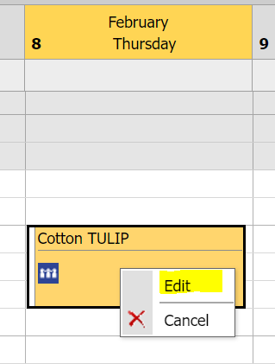
Correct way to record a DNA – best practice
The correct way to complete a DNA for a client is from the CDIS calendar
This ensures a note is written to the client’s file, the DNA is reportable in the DNA Report, and enables re-booking the cancelled appointment.
From within the CDIS Calendar:
Select the client that did not attended and right click on the appointment/
Click on Edit to open the appointment

Slide 8
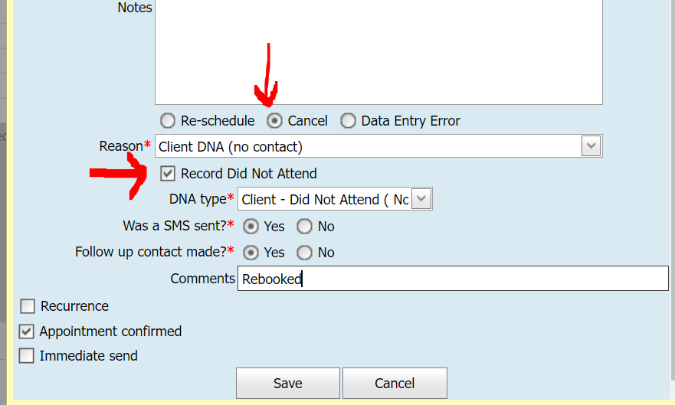
Correct way to record a DNA – best practice
Click the ‘Cancel’ radio button*, and select a Reason from the drop-down list
Click the checkbox ’Record Did not Attend’ and select a DNA type from the drop-down list
*You must click ‘Cancel’ to remove the appointment from the calendar and allow rebooking of the missed KAS appointment
Fill in the two remaining mandatory radio buttons and enter a comment before clicking Save.
This will ensure CDIS records the DNA, both in the client’s Service History (on the client’s summary page) AND in the client’s history / notes (shown below).
The DNA will also then be reportable via the DNA Report making it easier to run a report and track DNAs.

Slide 9
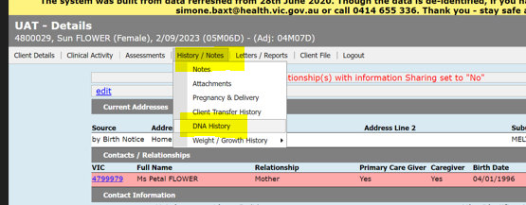
How to check DNAs for my clients and for my centre?
In client CDIS record:
History / Notes Tab
DNA History

Slide 10
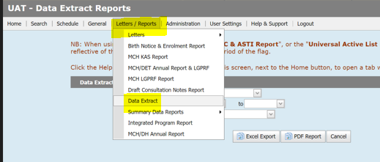
How to check DNAs for my clients and for my centre?
DNA Report steps:
Home page
Letters / Reports menu
Data Extract Report
DNA report
Notes:
Fill in the fields – time frame and site/center
Best Practice to run at end of the month/week to see DNA for your clients to ensure follow up

Slide 11
Adding Email to Signature Block
This must be authorised at Management Level as it impacts all letter and referral templates for your service for all users.
Your Signature Block can be changed by either:
Emailing CDIS Support for some or complete assistance:
You may have someone in your MCH service with the role ‘System Admin-Council’. They can investigate your current layout (steps 1-4 below) and make changes (following all the steps below).
If you require CDIS Support to help, send an email requesting they send your current signature layout for review, and/or update them with the information and order you wish for your layout.
If you have a CDIS user with a role ‘System Admin – Council’ they can follow the instructions below to update your signature with email.

Slide 12
Adding Email to Signature block
This must be authorised at Management Level as it impacts all letter and referral templates for your service for all users.
Log into CDIS
Accept the log in agreement
Navigate to the Administration> Settings Parameters
Scroll to the section Signature Block
Update the Text in the white area, with any of the fields listed on the right-hand side, spelled the same way, ensuring you include the square brackets. Tip: Copy & paste to avoid error.
See next slide for example
Scroll down and click save
Notes:
The information comes from the user profile – so ensure no private details are listed eg private mobile – and private email.

Slide 13
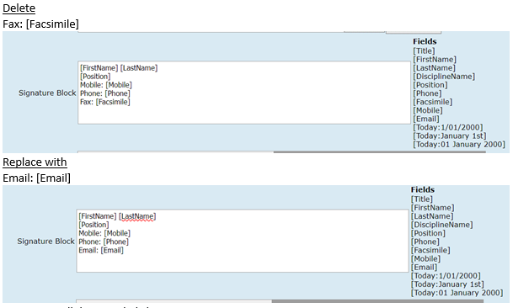
Adding Email to Signature block
Example:
This must be authorised at Management Level as it impacts all letter and referral templates for your service for all users.
NB: Do not update other fields, even if you see MAV email addresses. These are all managed at a state-wide level and have been changed to required details managed by The Department. Changing these may cause local issues.
NB: This could take 24 hours to replicate across the system and be available for all users
Notes:
For consideration think about part time staff and emails/contact to private emails if not monitored regularly. Eg for LSL. AL, etc

Slide 14
Appointments Allocations Function/Screen
From Childs History
Select Client Details – Appointment Allocation
3. Select client current sites/offices or all sites/office – see yellow highlight below
Show appts will display booked appts.
Notes:
Please note the appointment will prepopulate with the client details of the history you are accessing the appointments allocation from.

Slide 15
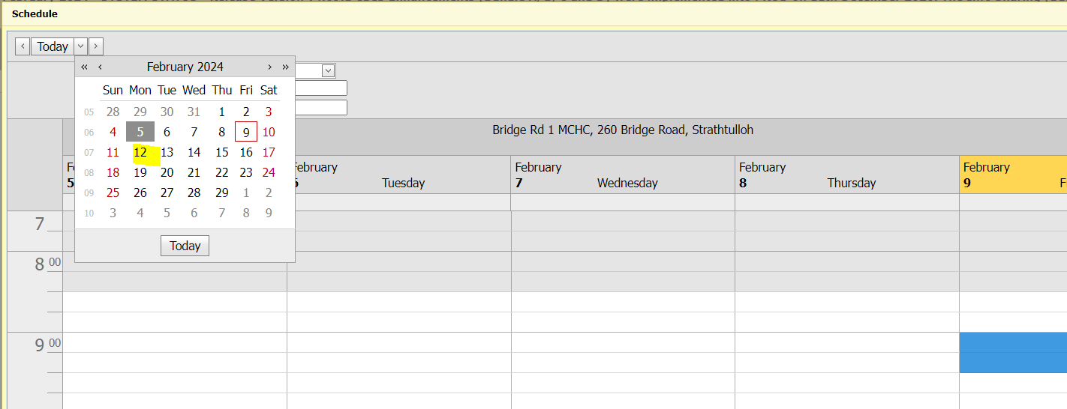
Appointments Allocation Function/Screen
See selected site and tick show appointments
Click on site eg Bridge Road, then a schedule calendar window will pop up.
Select your date

Slide 16
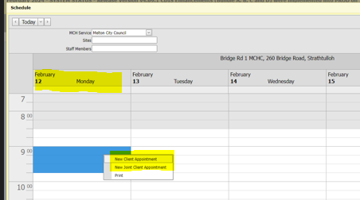
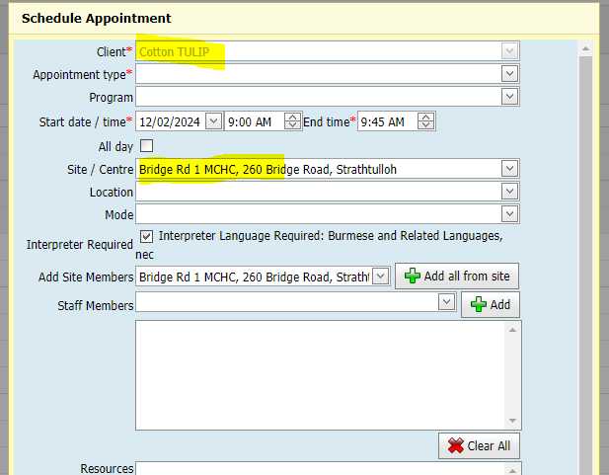
Appointments Allocation Function/Screen
Select your time
Right click for new client appointment option
Scheduled appointment pops up
with prepopulated client details.
Add appointment type and
any other details to make appointment

Slide 17
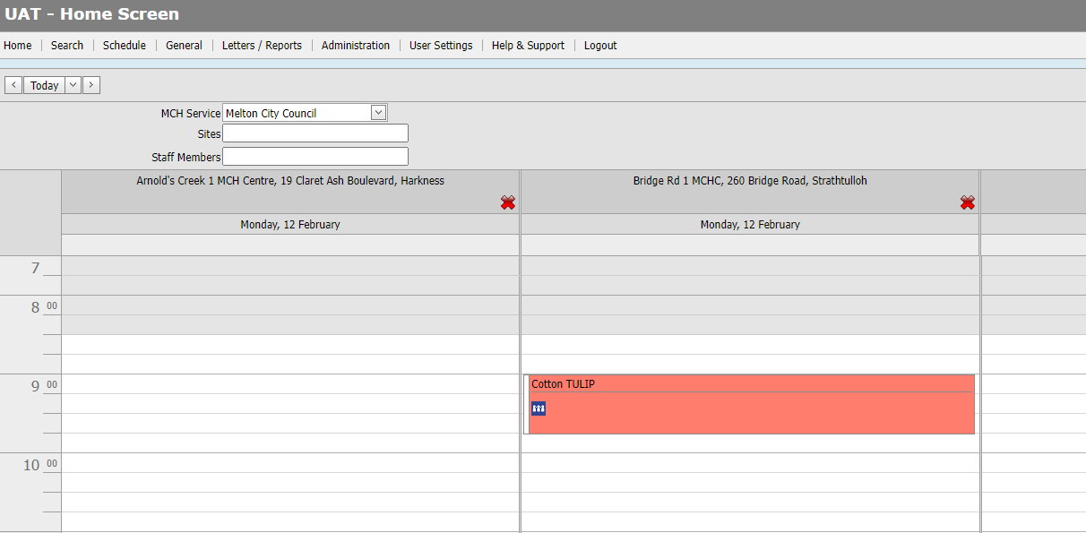
Appointments Allocation Function/Screen
Appointment recorded in Consults and in calendar

Slide 18
Comments and Feedback from Session
Feedback: Reminder to please attach email correspondence as an attachment to the CDIS record.
Details such as sender name and contact details are missing from emails when cut and paste into the CNP.
Can we send links to KAS via SMS from CDIS?
Yes, see CDIS Admin User group slides with more information regarding SMS

