Slide 1
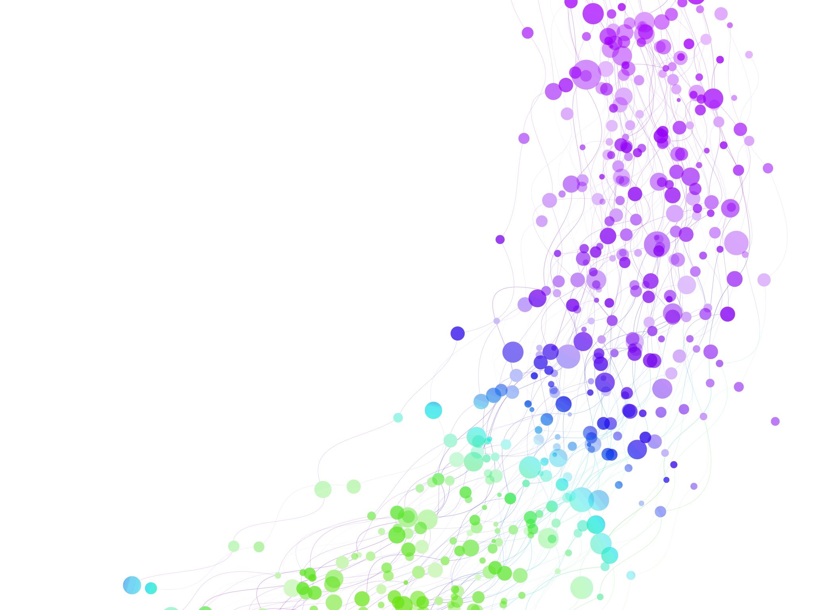
Child Development Information System (CDIS)
CDIS User Group – Admin
December 2024

Slide 2

Agenda
Tips & Tricks
  Creating Relationships
  What does it meant when a family is highlighted green?
Poll Topics:
  CDIS Site request forms
  Birth Notification List
Q&A
  Birth Notifications Legislations
2025 Dates

Slide 3
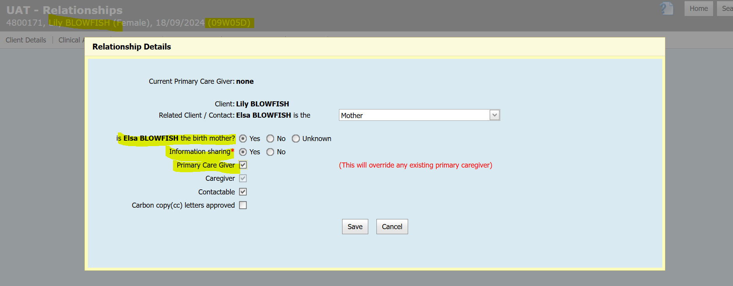
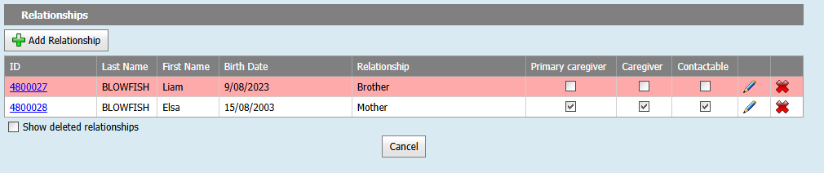
Creating Relationships
Best practice to record from the child's history
The questions/status fields are more appropriate for the adult in the relationship so having the adults as the related person on the popup makes sense.

Slide 4
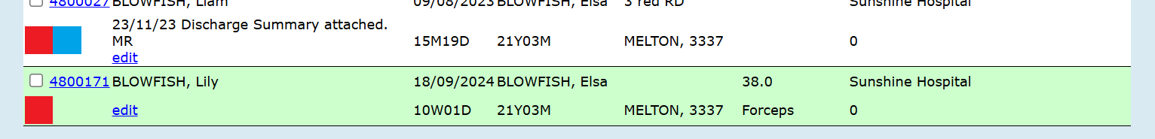
What does it mean when a family is highlighted in green in Program Active list?
Records in any screen list that are "green", are due to either:
being transferred in from another MCH service
being transferred (changed) to a different site within the same MCH service
Further notes of interest:
This colour was designed to alert users these clients are new to the site or service, and in the "list" and not to be overlooked
if they remain on the list, they will remain green on the respective "screen list" (e.g. Program Active List) for 7 days
Notes:
//Universal Active List
Will displays green if the client has at least one transfer.
This does not match the use case.
///Birth Notification List
Will display green if the client has at least one transfer.
This does match the use case.
///Programs Active List
Will display green if the client has a transfer in the last 7 days.
There are no specs in the use case for this.
Plan -
Ensure all three screens have the feature: Highlight green if the client has had a transfer in the last 7 days

Slide 5
Request from Poll to cover:
CDIS Site Request forms
Please follow the instructions clearly on the CDIS site request form.
This will ensure that the process runs smoothly
What are the questions you have about this process?

Slide 6
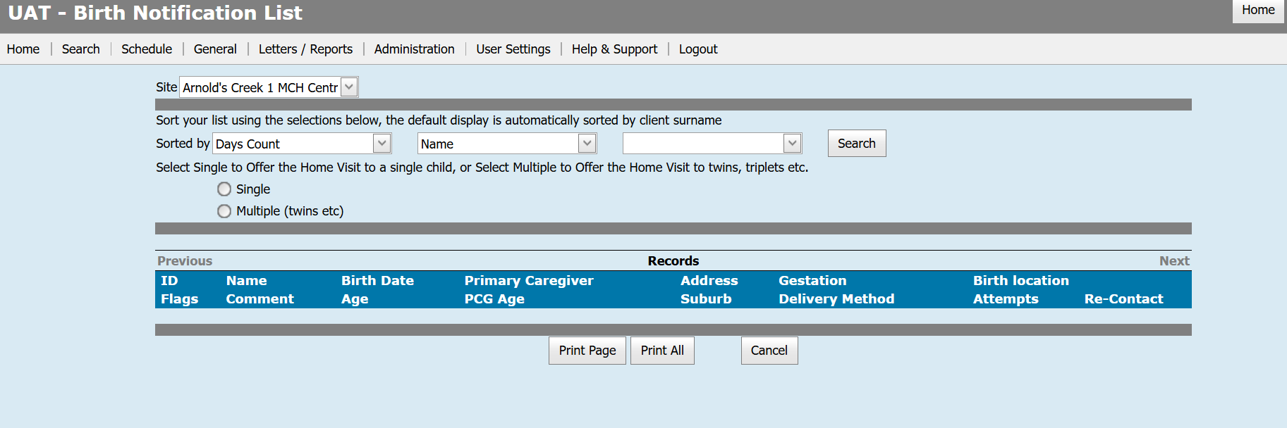
Request from poll: Birth Notification List
What would you like to discuss:

Slide 7
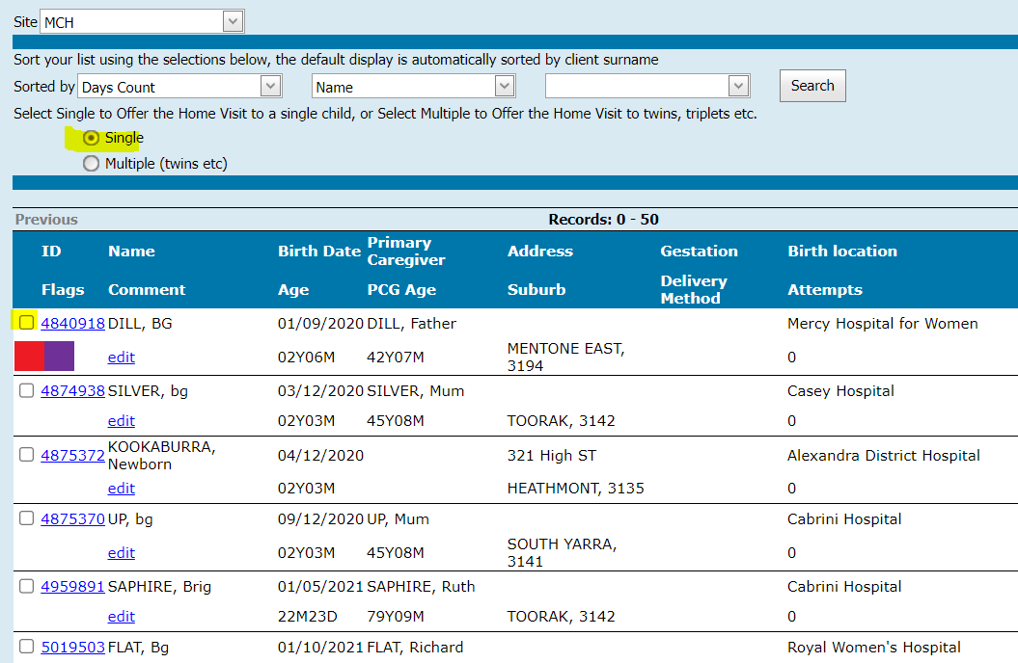
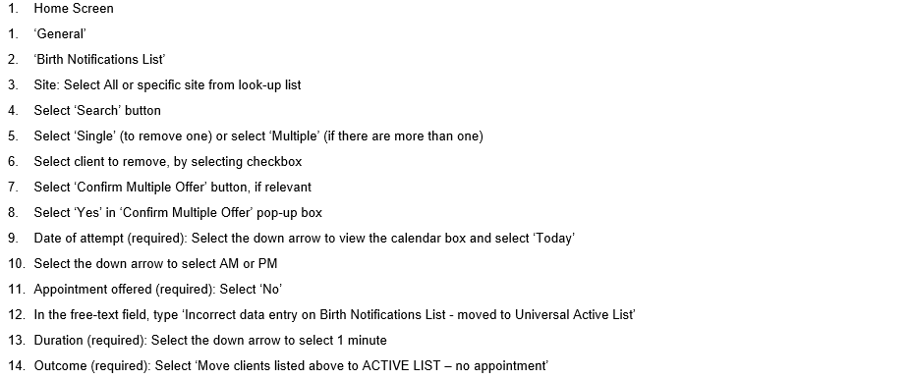
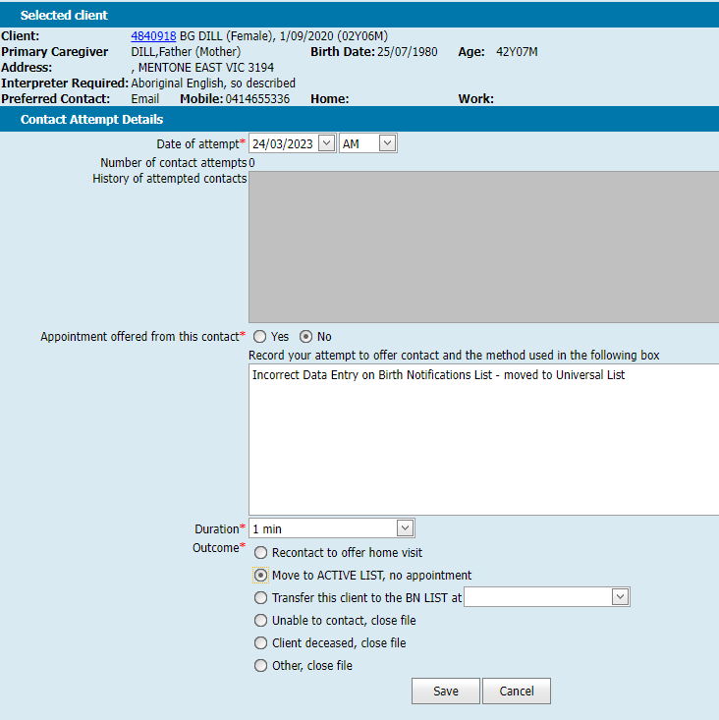
How to remove a client who is incorrectly on the birth notification list

Slide 8

Birth Notification List and prem babes
Streamlining the process for best practice:
Using the edit feature on BN List to track gestation, discharge and HV appt.
Use the HV offer to track and recording no appointment offered at this contact with a note will support this (see snip below)
Client not present entered when receiving an update from maternity neonatal service by MCHN.
Best practice is to keep baby on the BN list, so the baby does not get missed for their HV.
Tip from Frankston: Frankston MCH service have standardized their edit notes to enable filtering for appointments.
FILTER the Birth Notification List (using the print all feature) by: 'Comment' under 'sorted by.’
In the Edit note: we type in HV 2024/11/12 (year/month/day) which puts clients into date order allowing us to call clients from the top of the list to the bottom. We start calling the clients two days before the shown date.
For SCN babies we start the edit note with SCN (Centre name), whatever other details you want to add. This puts the SCN babies straight to the end of the list.
*For the date order to work 'HV' or 'SCN' must be at the very START of the edit note.

Slide 9
Birth Notifications Legislation
Child Wellbeing and Safety Act
43 Early notification of births
(1) If a child is born in Victoria notice of the birth of the child (the birth notice) must be given by the responsible person to—
(a) the Chief Executive Officer of the council of the municipal district in which the mother of the child usually resides; or
(b) if the municipal district is not known to the person giving notice, the Chief Executive Officer of the council of the municipal district in which the birth occurs; or
(c) if the mother of the child usually resides outside Victoria, the Secretary to the Department of Education and Training.
(2) The notice must be in the prescribed form.
(3) In this section, responsible person has the same meaning as it has in section 12 of the Births, Deaths and Marriages Registration Act 1996.
Child Wellbeing and Safety Regulations
10 Early notification of births
For the purposes of section 43(2) of the Act, the form set out in Schedule 1 is prescribed.
Schedule 1, Regulation 10 of Child Wellbeing and Safety Regulations - next slide

Slide 10
