Slide 1
End of life: Working out what to do
Date: 24 October 2019
Presenter: Rebecca Woodyatt

Slide 2
Why investigate?
Moral Case
Everyone is affected
Significant community issue
Taboo subject
Business Case
CEO interest
Future business model
Discrete events already occurring

Slide 3

Initial thinking
What’s the greatest impact?
Where can Council make impact?
How can we do this?

Slide 4
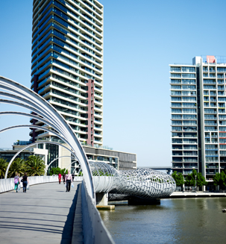
Report parameters
Definitions end of life versus palliative care
Policy environment
Models, frameworks already in use
Current and previous projects
What’s already happening/what’s missing in Melbourne?

Slide 5
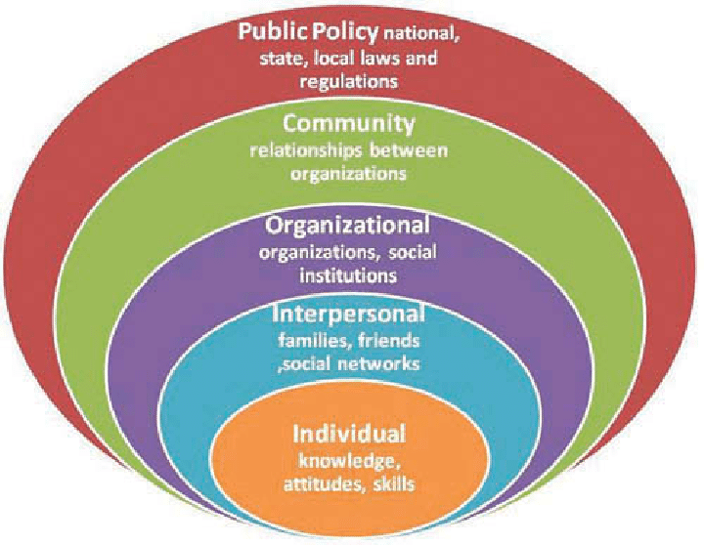
Building recommendations
Socio-ecological model
Socio-ecological model:
Centers for disease control. Available from the Centers for Disease Control and Prevention (CDC).

Slide 6
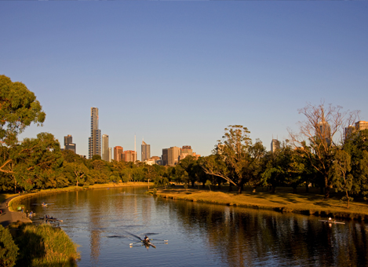
What have we done since?
2018 Seniors Festival
Draft Ageing Strategic Plan
Discussions with Portable

Slide 7
Finally
Key learnings
Things don’t happen quickly
Political environment can change – be ready to change with it
Benefits to having a detailed resource
What next?
Community engagement for Ageing Strategic Plan focus areas

