Slide 1
CDIS Additional assessment tools
January 2021

Slide 2
Three new assessment tools have been added to CDIS
Parent and carers psychosocial assessment
Parent-child interactions scale - Infant and toddler (Brigance III)
Sleep Pathways Assessment form (This tool replaces the infant sleeping tool)

Slide 3
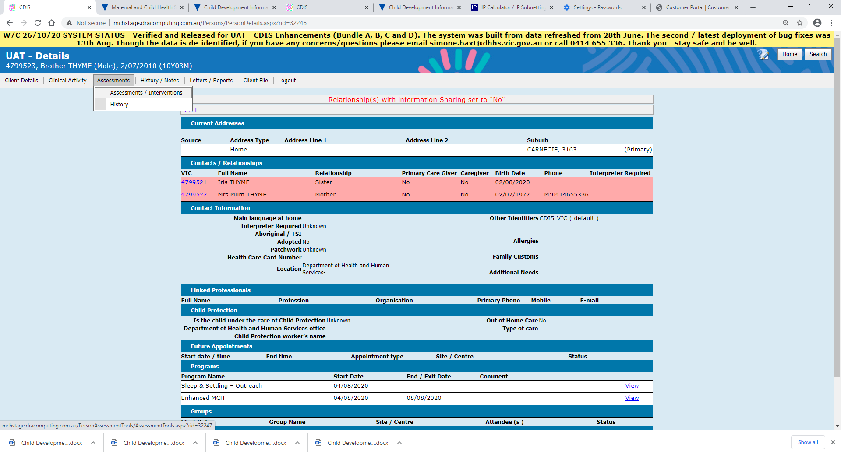
How to access the tools
All new online Assessment Tools are available from the Assessments Menu > Assessments /Interventions

Slide 4
Accessing the tools within consultations
Consultation type | Parent and carers psychosocial assessment | Parent-child interactions scale - Infant and toddler (Brigance III) | Sleep Pathways Assessment Form
Home Visit | ü | ü
2-week | ü | ü
4-week | ü | ü
8-week | ü | ü
4-month | ü | ü
8-month | ü | ü | ü
12-month | ü | ü | ü
18-month | ü | ü
2 year | ü | ü
3.5 year | ü | ü
Additional Consult | ü | ü | ü
Family Consultation | ü | ü
Enhanced MCH | ü | ü | ü
Sleep and Settling - Outreach | ü | ü | ü

Slide 5
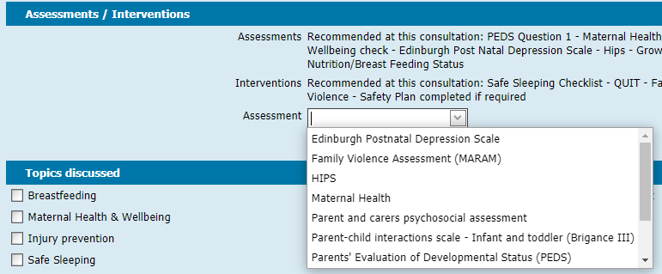
How to access tools
Select assessment tools from the Assessment dropdown box in the Assessments / Interventions section of the consultation screen, as per existing practice.

Slide 6
Tool access from client records
Universal MCH Program
The new tools are accessed from the client record of the child who is being assessed. The assessment will be then be saved against that child’s record.
Note: To be consistent with consultation process:
Ensure you are in the correct client file before entering any data.
All universal consultations are counted for reporting purposes against the child record
All consultations are to be recorded from the child record – only in extenuating circumstances should a ‘consultation’ be recorded from the mother’s record.
Enhanced MCH Program | Refer to CDIS Enhanced MCH Guide
Sleep and Settling Outreach Program | Refer to CDIS Sleep and settling outreach guide

Slide 7
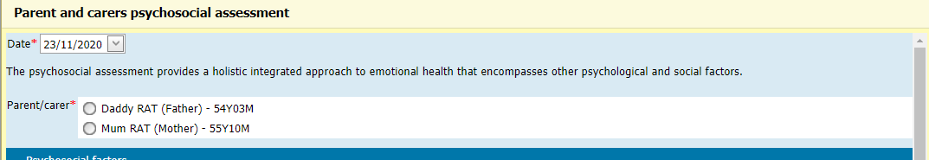
Assessment Tools
Parent and carers psychosocial assessment
At the top of the screen you are asked to select the parent/carer who is present. A parent/carer present must be selected when using this tool. This information will be recorded as part of the assessment information in the child’s client record.

Slide 8
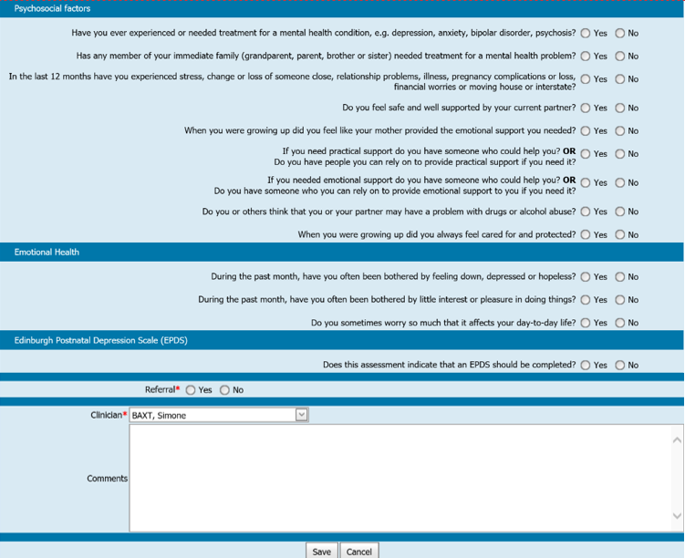
Assessment Tools cont:
Parent and carers psychosocial assessment
Complete the form in accordance with the principles included in Perinatal mental health and psychosocial assessment: Practice resource manual for Victorian maternal and child health nurses, then click Save

Slide 9
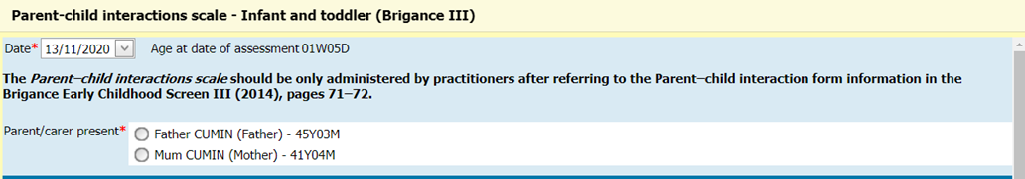
Assessment Tools cont:
Parent-child interaction scale – Infant and toddler (Brigance III)
At the top of the screen you are asked to select the parent/carer who is present. A parent/carer present must be selected when using this tool. This information will be recorded as part of the assessment information in the child’s client record.
Note: The Parent–child interactions scale should be only administered by practitioners after referring to the Parent–child interaction form information in the Brigance Early Childhood Screen III (2014), pages 71–72.

Slide 10
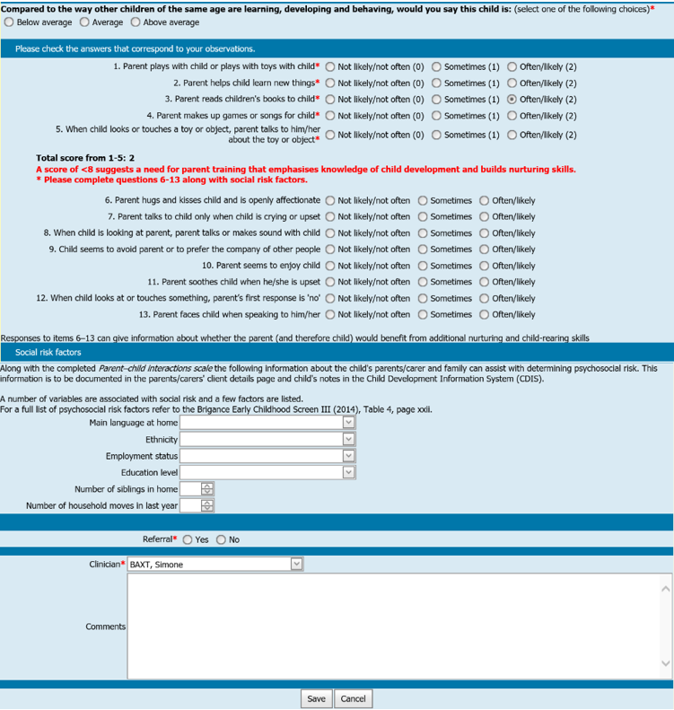
Assessment Tools cont:
Parent-child interaction scale – Infant and toddler (Brigance III)

Slide 11
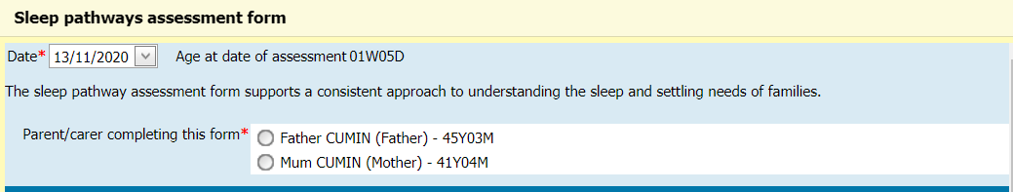
Assessment Tools cont:
Sleep pathways assessment form
At the top of the screen you are asked to select the parent/carer who is present. A parent/carer present must be selected when using this tool. This information will be recorded as part of the assessment information in the child’s client record.

Slide 12
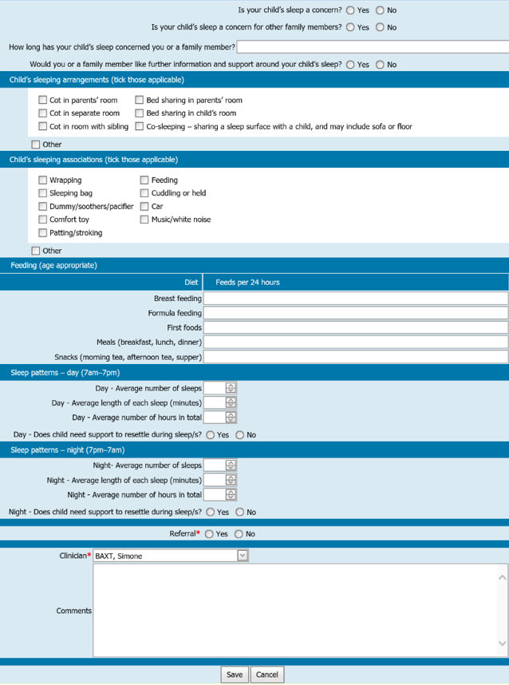
Assessment Tools Cont:
Sleep pathways assessment form
Complete the assessment in accordance with Sleep and settling model of care, then click Save

Slide 13
Reporting
The current MCH KAS Report built into CDIS includes a “Sleep Intervention” count for the 8-month KAS consultation.
This count will no longer be accurate, as it does not count uses of the new “Sleep Pathways Assessment Form”.
There will be a new report developed to provide accurate counts of assessment tool usage in the future.

