Slide 1




CDIS User Groups
October 2025
CDIS User Group – October 2025

Slide 2

The Municipal Association of Victoria acknowledges the Traditional Owners of Country throughout Victoria, and recognise their continuing connection to lands, waters, and culture.
We pay our respect to Elders past and present who carry the memories, traditions, cultures, and aspirations of First Peoples, and who forge the path ahead for emerging leaders.
The MAV acknowledges the important role of cultural practices that have supported the health and wellbeing of mothers, families and their babies for thousands of years
Collaboration
Cassie Leatham I Charlie Miller I Lisa Waup
Spacecraft Studio I MAV
2023
CDIS User Group – October 2025

Slide 3

Agenda
Tips & tricks
Assessment History
Filtering
Caregivers & Information sharing
Information Sharing Process
Transfers
Recording Gender
FAQs
Q&A
CDIS User Group – October 2025

Slide 4
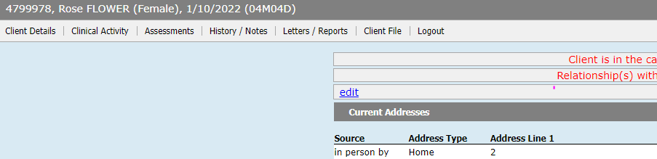
Tips & Tricks
Open/Change/Close Client – ensure that children and all relevant relationships are open for service as per clinical judgement.
When booking Home Visit in calendar add a note with the babies DOB/CDIS # so that it can been seen in the appointment screen.
Best practice when recording pronunciation of names please place in edit tab on front page not as part of the name as this is a medical record:
CDIS User Group – October 2025

Slide 5
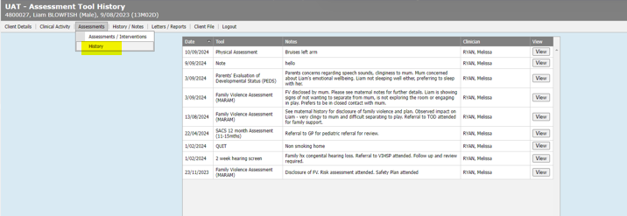
Assessments history – quick way to check recent assessments and outcomes
Clinical slide
CDIS User Group – October 2025
Notes:
Use CDIS – show Assessments history page for quick handover.
Good to use for Information Sharing

Slide 6
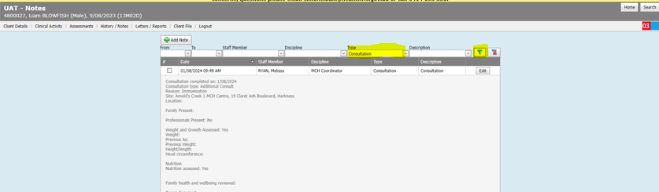
Using filtering function when searching in progress notes
Clinical slide
CDIS User Group – October 2025
Notes:
The filtering function in the progress notes is a good way to filter by staff or by description.

Slide 7
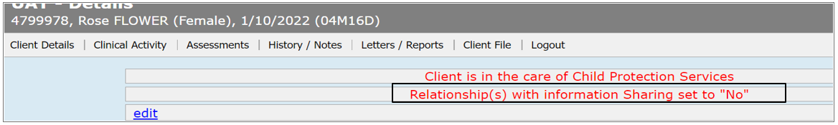
Relationships
What does Relationships with Information Sharing set to “N0” mean on the client file:
What that relationship Sharing set to No means is:
This pop up means that there is relationship to this client who has information sharing set to no.
Please review relationships before sharing information.
CDIS User Group – October 2025

Slide 8
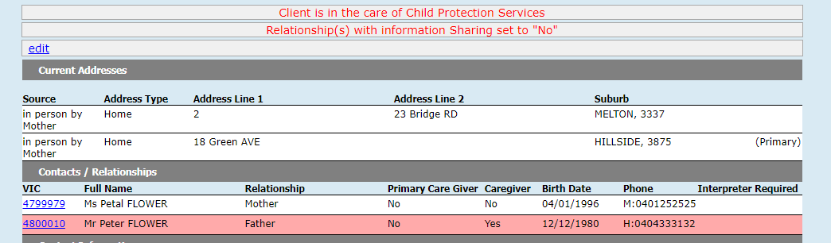
Caregivers with Information Sharing set to ‘No’
What do you do when a parent calls up and asks when is the next MCH appointment, but that parent has information sharing set to ‘No’?
CDIS User Group – October 2025

Slide 9
Relationships
Troubleshooting this scenario:
Can I take your details and get back to you.
If concerned ask for MCH Team Leader to read the notes to assess risk
Offer to resend the invite to the PCG selected
Ask parent on the phone to talk to person listed as PCG to call and discuss information sharing permissions.
CDIS User Group – October 2025

Slide 10
Information Sharing Processes –
Receiving an information sharing request
First ensure the ISE is verified, if it is also RAE, if request is for assessment purpose by:
    Immediate call back to confirm organisation: or
    Requesting an email for ISE to verify organisation credentials in email signature
Best Practice - ensure that sufficient information is provided by the ISE requesting information so that you can make a clinical decision regarding your response and information shared. See information sharing checklist resource.
Record Information Sharing (IS) request on CDIS
CDIS User Group – October 2025

Slide 11
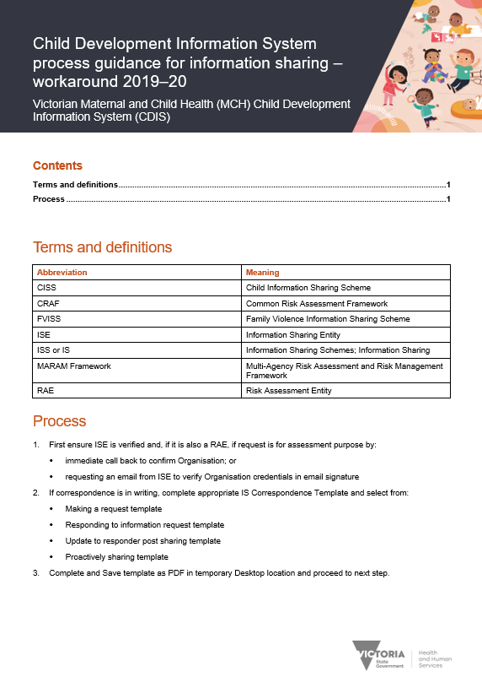

CDIS Processes – receiving a request
Place IS request in the appropriate CDIS record – ie for the safety of the child place in the child’s CDIS record.
Process as per 2019-20 process guide
Found here
Clinical slide
26
Gippsland Region PD Day
CDIS User Group – October 2025

Slide 12
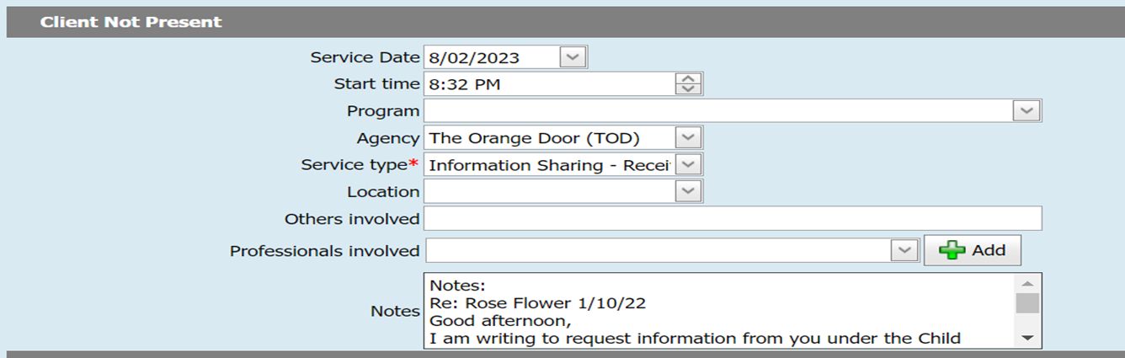
CDIS Processes (cont) – receiving a request
Alternatively the agency can be selected from the drop down box. This appears to be the more common method of recording IFS requests:
Paste email into notes
Paste email into the notes
CDIS User Group – October 2025

Slide 13
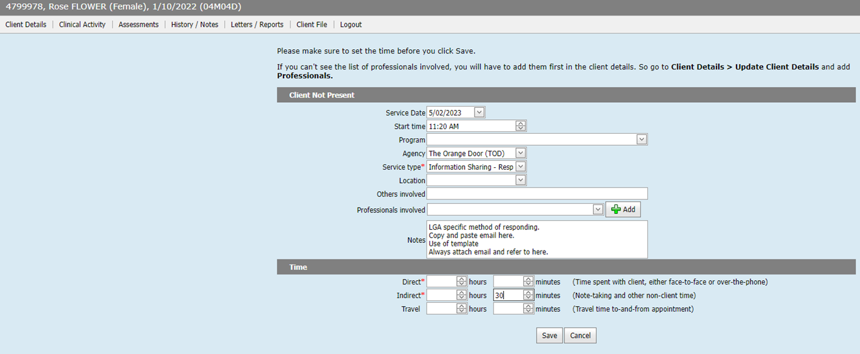
CDIS Processes (cont) – responding to a request
LGA specific method of responding.
Copy and paste email here.
Use of template is optional.
Always attach email.
CDIS User Group – October 2025

Slide 14
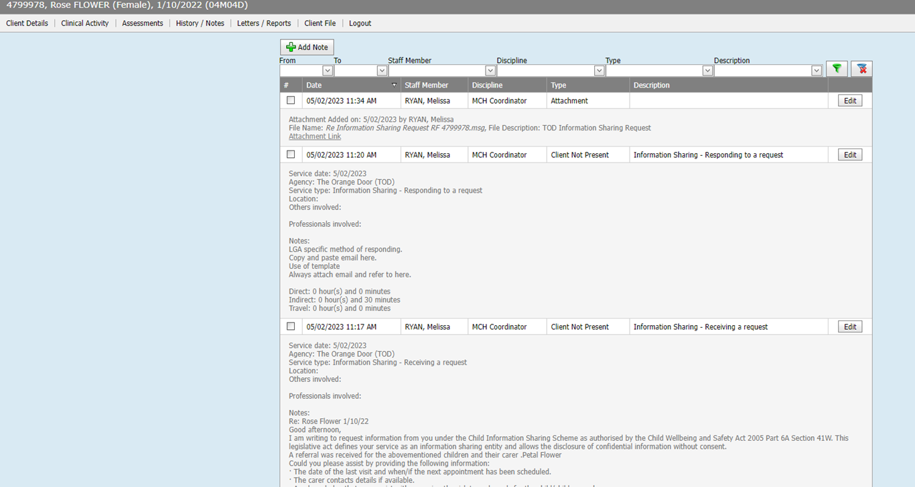
CDIS Notes View
Clinical slide
CDIS User Group – October 2025

Slide 15

Process continue
Information sharing request to be included in primary caregivers' history also if relevant and appropriate.
Attach email correspondence
Adding to the primary caregiver history provides a history of IFS requests and risk.
Add flags as required
Follow up appointments as required
Unable to pull a report from CDIS to capture the increasing work in this space.
Some councils are tracking their own IFS requests for data and follow up.
CDIS User Group – October 2025

Slide 16
Information Sharing Resources
https://www.health.vic.gov.au/maternal-child-health/child-development-information-system?rid=196458
CDIS process guidance for Information Sharing workaround
https://www.mav.asn.au/what-we-do/policy-advocacy/social-community/children-youth-family/maternal-and-child-health-children-0-6-years/Information-Sharing-and-MARAM-Reforms
MAV Information Sharing for MCH services. Correspondence templates and supporting tools.
Admin team please escalate any Information Sharing requests with your clinical lead.
CDIS User Group – October 2025

Slide 17
Transfer of clients on CDIS
If a client calls and says they have moved to another Local Government Authority (LGA)/Aboriginal Community Controlled Organisation (ACCO)/Health Service
Please direct them to call the new LGA or ACCO
Best practice is for you to contact the service and advise of the move.
DO NOT CLOSE the CDIS history
CDIS User Group – October 2025

Slide 18
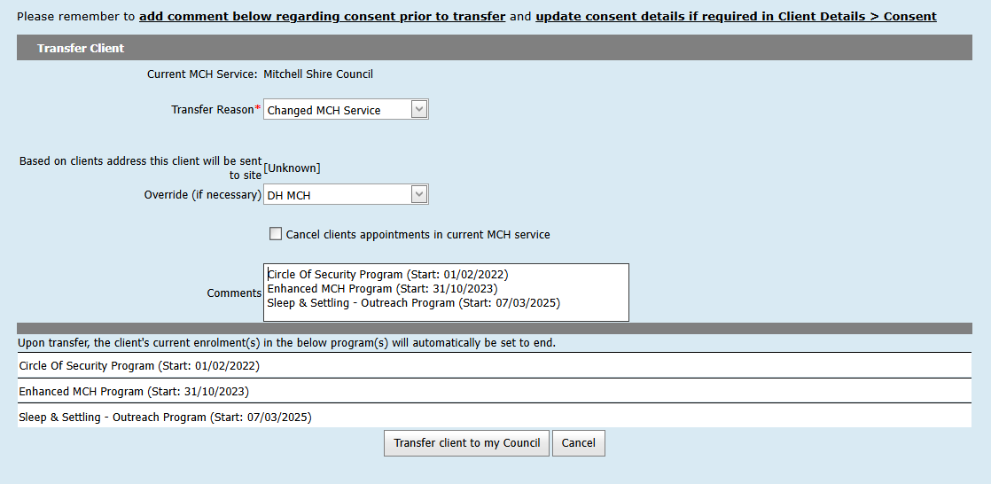
Transfers when clients are enrolled in a program at previous LGA or ACCO.
Best practice is to call the LGA or ACCO to advise of the families move and need to transfer CDIS record.
This gives the LGA or ACCO time to either close programs or provide an update.
This may need to be referred to your Leadership Team
PLEASE DO NOT TRANSFER WITHOUT CONTACTING LGA or ACCO
We should only transfer into our own LGA, as per CDIS Transfer Process
https://www.health.vic.gov.au/sites/default/files/migrated/files/collections/data/cdis/child-development-information-system-transfer-process.docx
PLEASE DO NOT “PUSH” A HISTORY TO ANOTHER LGA
CDIS User Group – October 2025

Slide 19
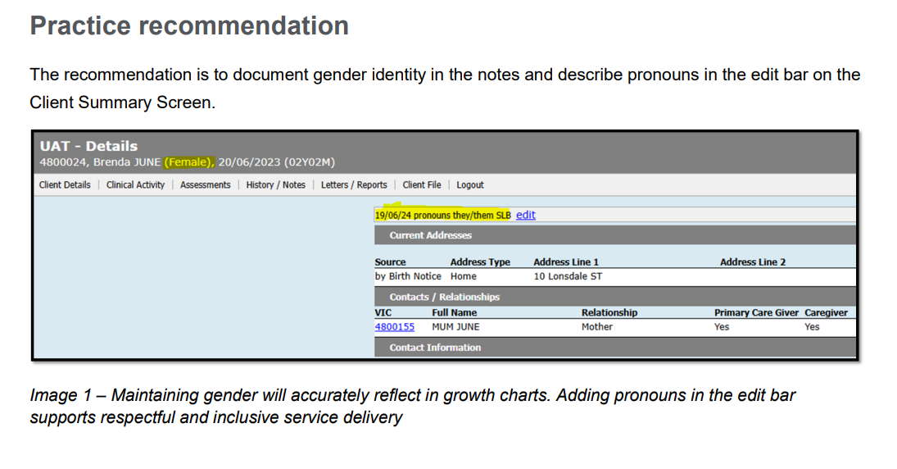
Recording Gender – practice note
CDIS User Group – October 2025
Notes:
Definitions
Gender is part of a person’s personal and social identity. It refers to a way a person feels and sees themselves. It can be about differences in identity, expression and experience as a woman, man or gender diverse person.
Sex refers to a person’s biological sex characteristics. This includes their sex chromosomes, hormones and reproductive organs. Sex recorded at birth Data collection often refers to sex recorded at birth. This is based upon a person’s sex characteristics and reproductive organs observed at, or soon after, birth.
Gender diverse is an umbrella term for a range of different genders. There are many terms gender diverse people may use to describe themselves. Language in this area is dynamic and always changing, particularly among young people. Some examples include genderfluid, genderqueer, gender non-conforming, agender, bi-gender and non-binary.
Transgender refers to someone whose gender does not exclusively align with their sex recorded at birth. Not all trans people will use this term to describe themselves.

Slide 20
FAQs
Fathers with a new baby, can their history be pulled from the previous council?
Histories should only be transferred following a conversation with the family about the relevant histories of the family group in the new LGA - don't make assumptions and transfer histories (partner or children) without knowing the circumstances?
What is the purpose of the time recording at the end of a KAS consult?
This is recommended as best practice. Whilst some things currently can't be extracted in a report - All entries into CDIS have the ability to be added to reporting in the future, time in universal consultations being one of them?
These time entries are recorded on the Integrated Programs (EMCH/Sleep & settling) Reports.
CDIS User Group – October 2025

Slide 21
CDIS Support (continued)
CDIS Support Hours
Monday to Friday between 8:30am to 5:30 pm
Contact
1300 856 183
cdis@support.vic.gov.au
CDIS User Group – October 2025

Slide 22


As the CDIS Champion for your MCH service you can access
the PowerPoint presentations on MAV MCH Resource page .
Please use these slides to update and educate your teams.
CDIS User Group – October 2025

